Slide 1
A Gentle Introduction to Quantum Computing
Paolo Cremonesi

Slide 2
References
This presentation is based on the book
Quantum Computing: A Gentle Introduction by Eleanor Rieffel and Wolfgang Polak (The MIT Press, 2011)
and on the courses
Quantum Computing: From Circuit To Architecture by Nicholas Mainardi (Politecnico di Milano, 2017)
Applied Quantum Machine Learning​ by Maurizio Ferrari Dacrema​ (Politecnico di Milano, 2020/21)
Other useful resources:
https://learn.microsoft.com/en-us/azure/quantum/concepts-overview
https://learn.qiskit.org/course/ch-algorithms/quantum-circuits

Slide 3
Outline of the course
Quantum Computing basic concepts and elements of mathematical formalism The gate model, how to mathematically represent gates and measurements, the problem of noise and decoherence Qubit Technologies
Gate-model Architectures and the problem of transpiling Few simple algorithms in details Other important high-level algorithms: Grover, Shor, HHL, QFT... Variational algorithms for optimization problems (QAOA) Adiabatic quantum computing & quantum annealing. How to measure speedup/quantum advantage

Slide 4

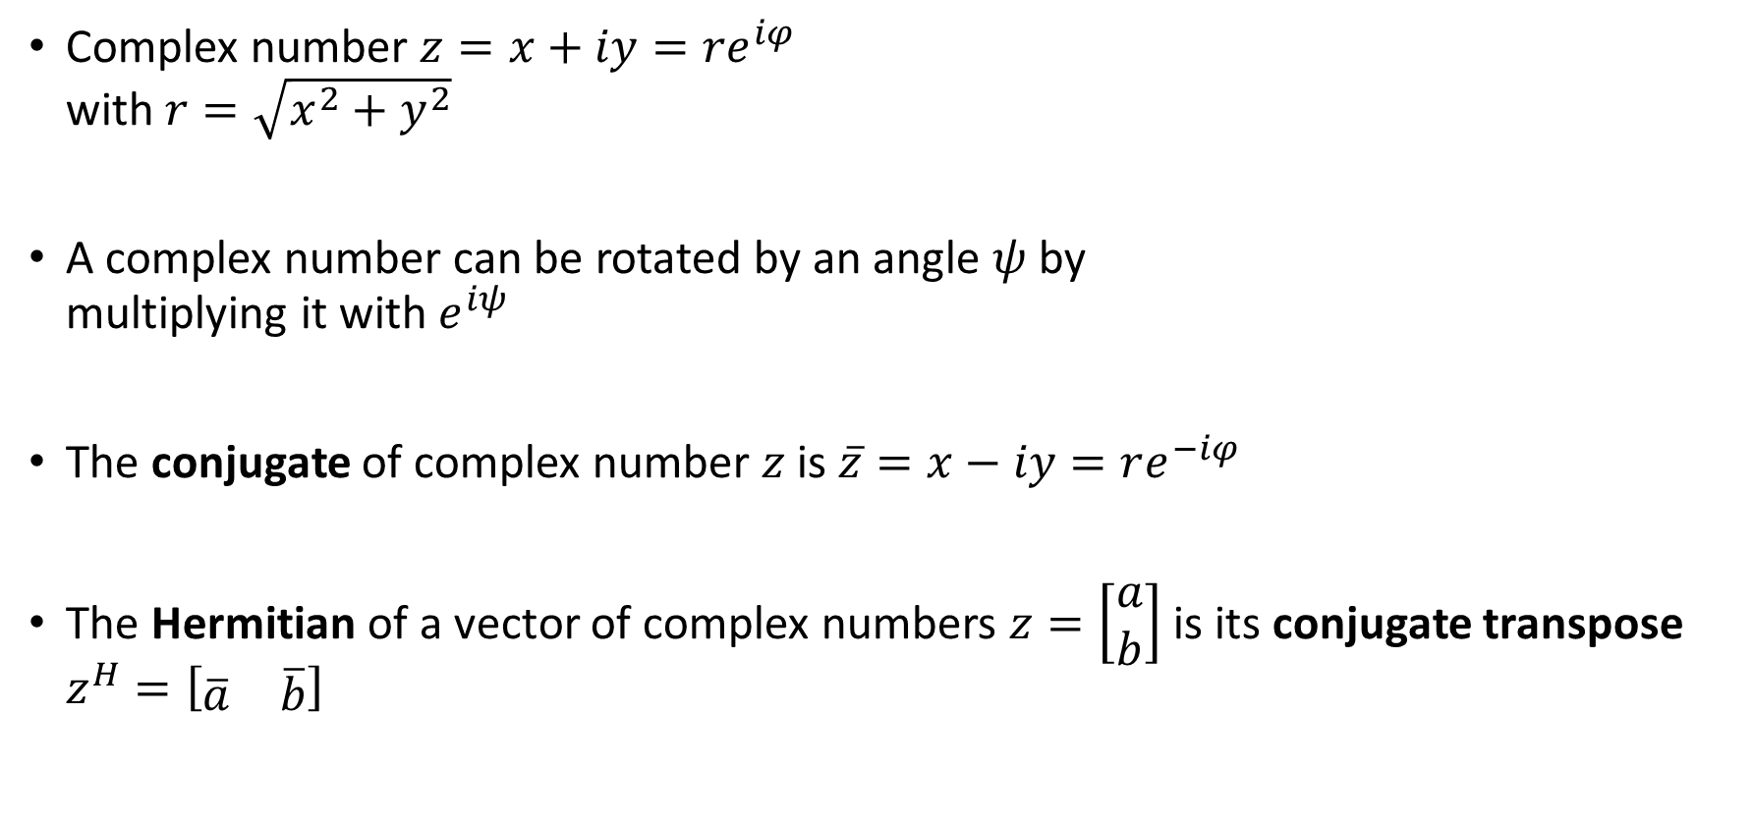



Complex numbers mini recap
imaginary
$$y$$
Complex number $z=x+iy=re^{iφ}$ with $r=\sqrt{x^{2}+y^{2}}$
A complex number can be rotated by an angle $ψ$ by multiplying it with $e^{iψ}$
The conjugate of complex number $z$ is $\overline{z}=x−iy=re^{−iφ}$
The Hermitian of a vector of complex numbers $z=\left[\begin{matrix}a \\ b\end{matrix}\right]$ is its conjugate transpose $z^{H}=\left[\begin{matrix}\overline{a} & \overline{b}\end{matrix}\right]$
$$r$$
$$φ$$
real
$$x$$

Slide 5

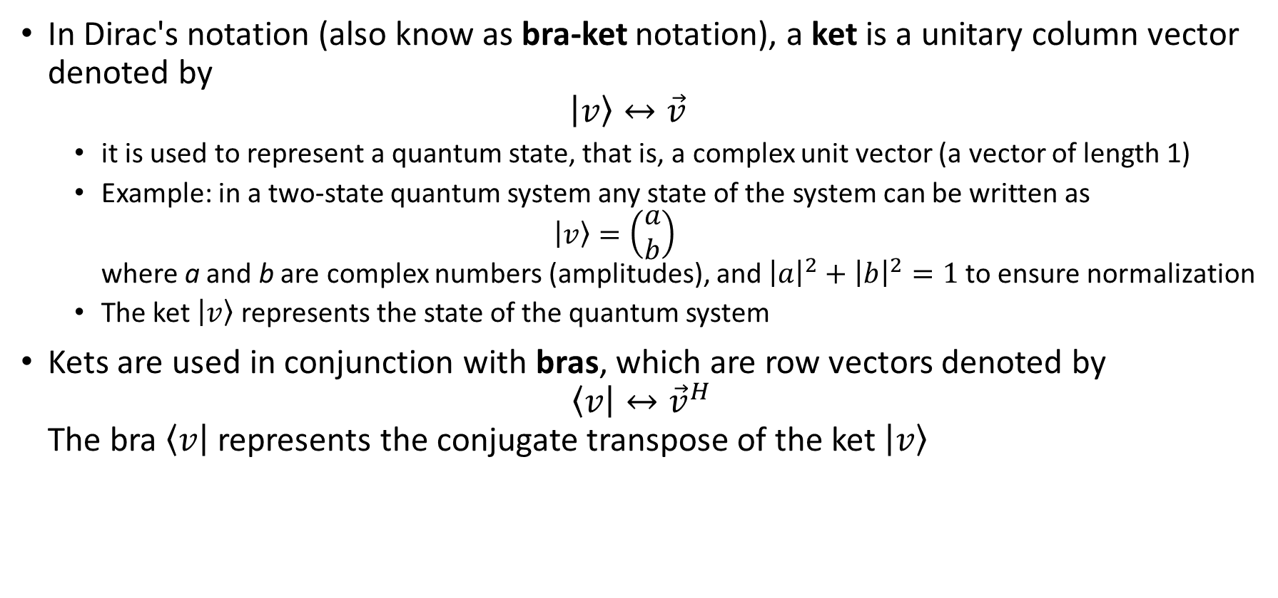
Dirac’s ket and bras
In Dirac's notation (also know as bra-ket notation), a ket is a unitary column vector denoted by $\left|v\right\rangle ↔\vec{v}$
it is used to represent a quantum state, that is, a complex unit vector (a vector of length 1)
Example: in a two-state quantum system any state of the system can be written as $\left|v\right\rangle =\left(\begin{matrix}a \\ b\end{matrix}\right)$ where a and b are complex numbers (amplitudes), and ${\left|a\right|}^{2}+{\left|b\right|}^{2}=1$to ensure normalization
The ket $\left|v\right\rangle$ represents the state of the quantum system
Kets are used in conjunction with bras, which are row vectors denoted by $\left\langle v\right|↔{\vec{v}}^{H}$ The bra $\left\langle v\right|$ represents the conjugate transpose of the ket $\left|v\right\rangle$
$$φ$$

Slide 6
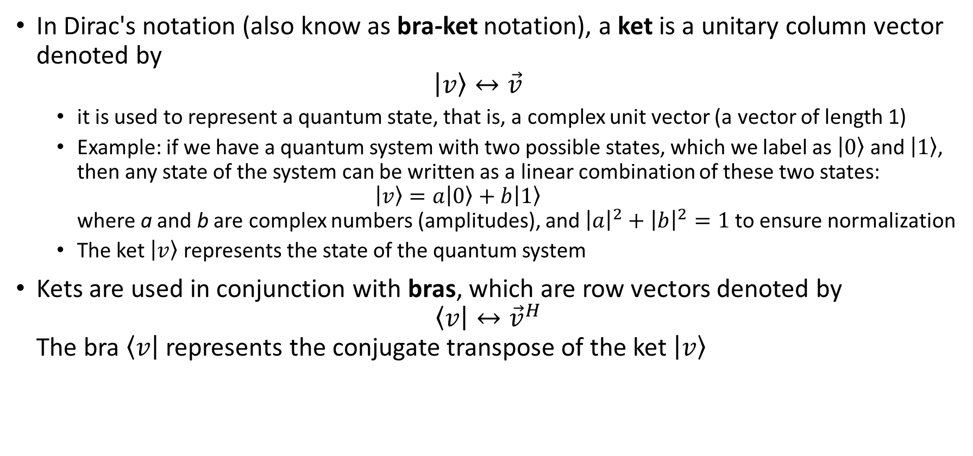
Dirac’s ket and bras
In Dirac's notation (also know as bra-ket notation), a ket is a unitary column vector denoted by $\left|v\right\rangle ↔\vec{v}$
it is used to represent a quantum state, that is, a complex unit vector (a vector of length 1)
Example: if we have a quantum system with two possible states, which we label as $\left|0\right\rangle$ and $\left|1\right\rangle$, then any state of the system can be written as a linear combination of these two states: $\left|v\right\rangle =a\left|0\right\rangle +b\left|1\right\rangle$ where a and b are complex numbers (amplitudes), and ${\left|a\right|}^{2}+{\left|b\right|}^{2}=1$to ensure normalization
The ket $\left|v\right\rangle$ represents the state of the quantum system
Kets are used in conjunction with bras, which are row vectors denoted by $\left\langle v\right|↔{\vec{v}}^{H}$ The bra $\left\langle v\right|$ represents the conjugate transpose of the ket $\left|v\right\rangle$
$$φ$$

Slide 7
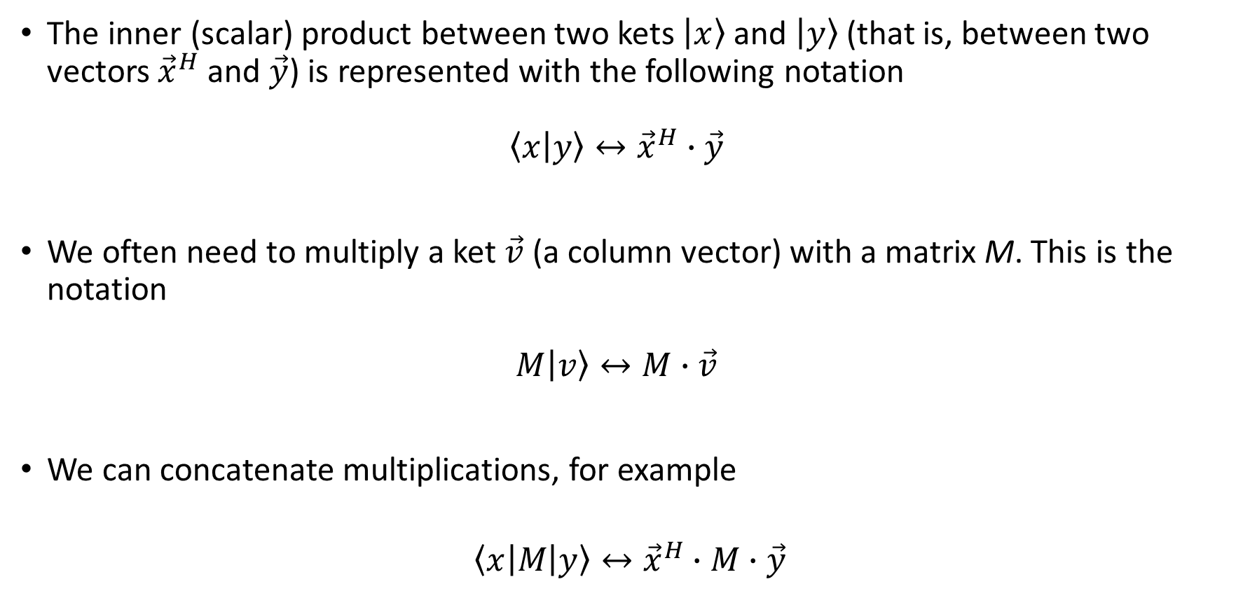
Dirac’s notation: multiplications
The inner (scalar) product between two kets $\left|x\right\rangle$and $\left|y\right\rangle$(that is, between two vectors ${\vec{x}}^{H}$ and $\vec{y}$) is represented with the following notation $\left\langle x | y\right\rangle ↔{\vec{x}}^{H}∙\vec{y}$
We often need to multiply a ket $\vec{v}$ (a column vector) with a matrix M. This is the notation $M\left|v\right\rangle ↔M∙\vec{v}$
We can concatenate multiplications, for example
$$\left\langle x\right|M\left|y\right\rangle ↔{\vec{x}}^{H}∙M∙\vec{y}$$

Slide 8
Build and measure qubits
A toy example
Laser beam
Photon detector

Slide 9
Build and measure qubits
A toy example
A
Laser beam
Photon detector

Slide 10
Build and measure qubits
A toy example
A
B
Laser beam
Photon detector

Slide 11
Build and measure qubits
A toy example
A
C
B
Laser beam
Photon detector

Slide 12
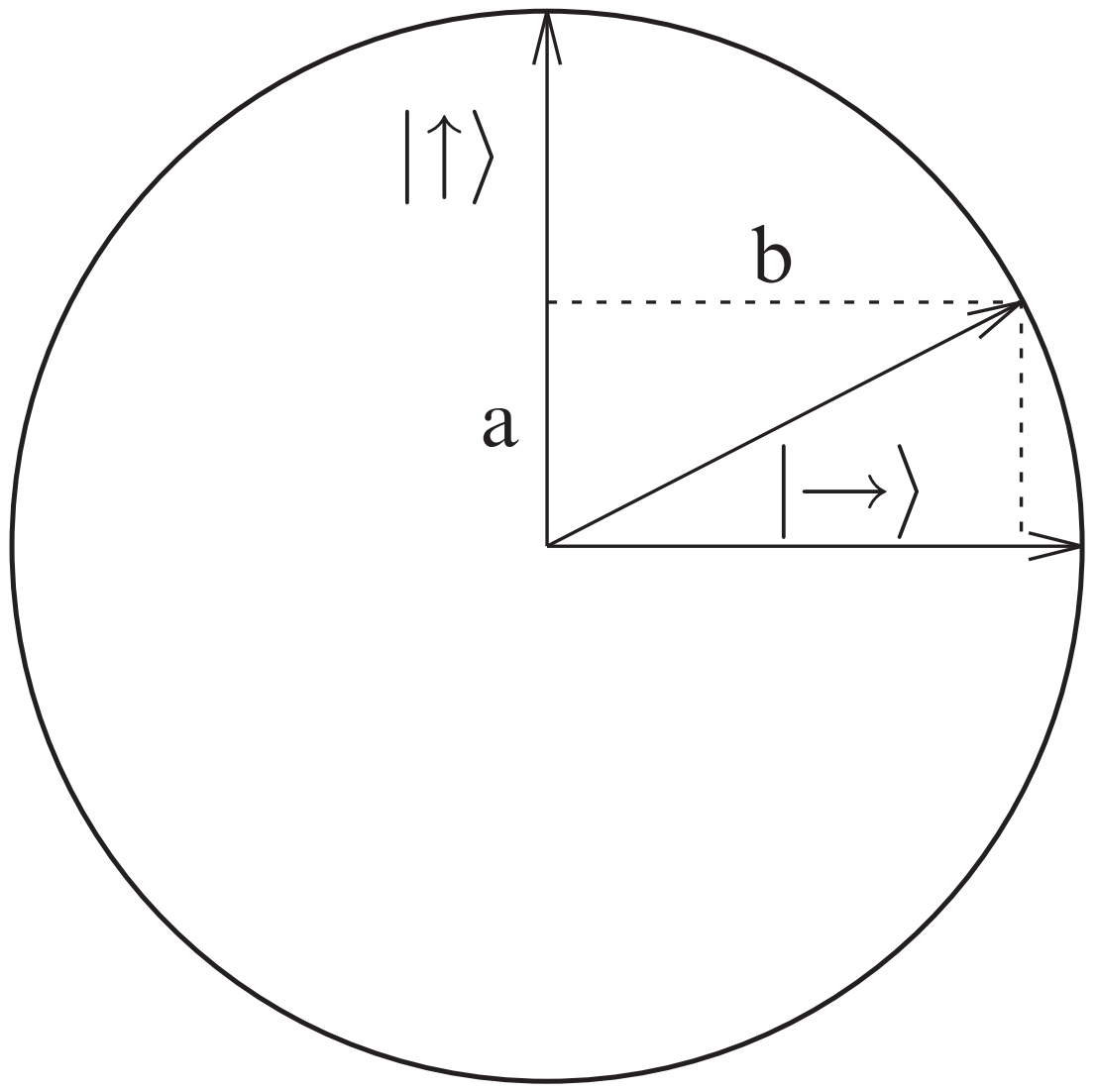
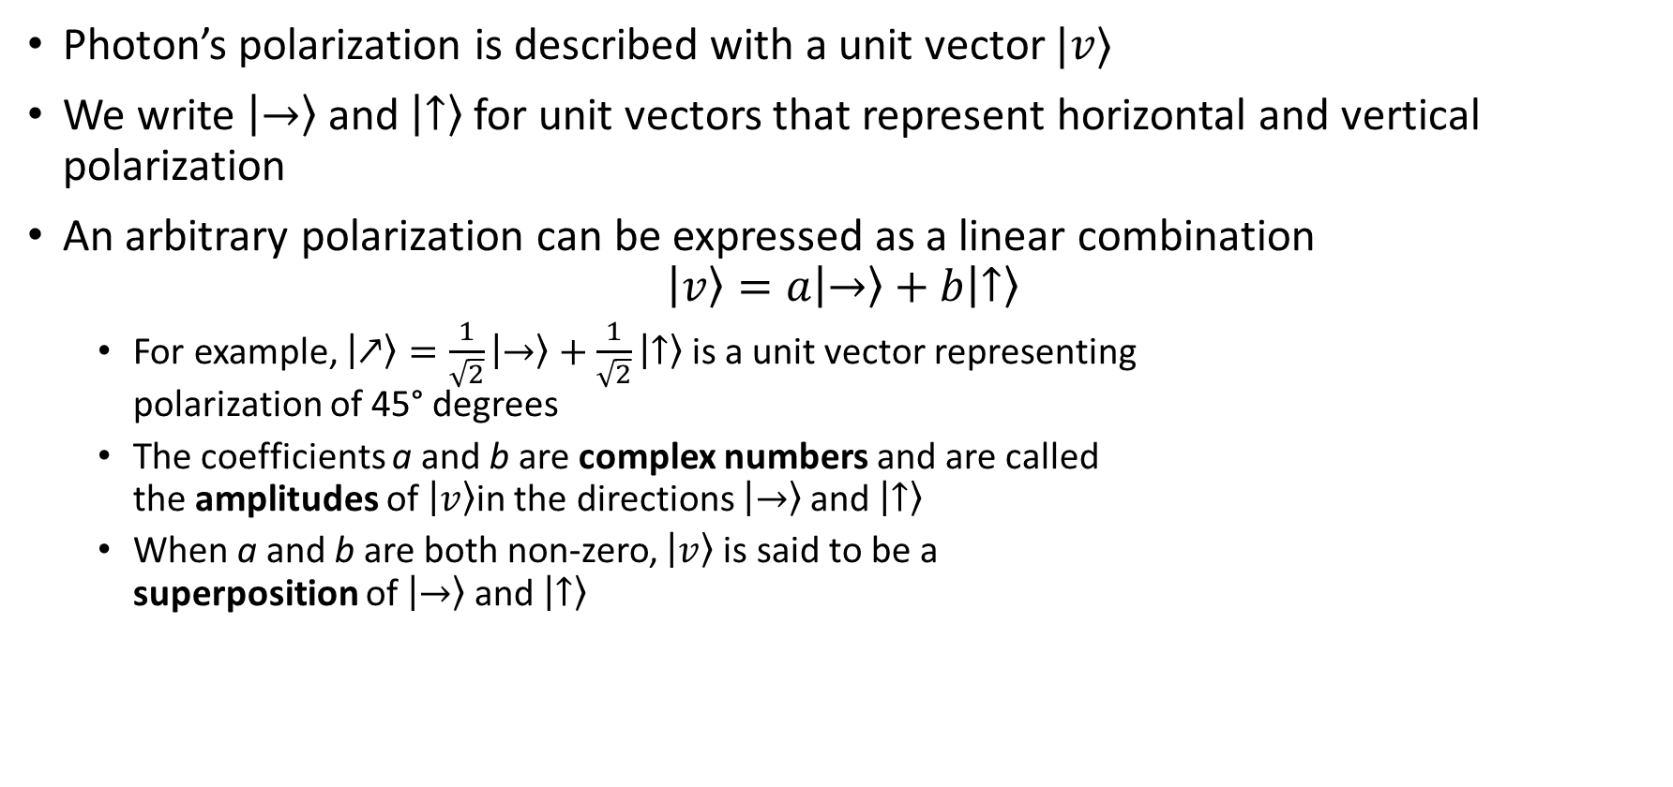
Photon’s polarization and qubits
Photon’s polarization is described with a unit vector $|v⟩$
We write $\left|→\right\rangle$ and $\left|↑\right\rangle$ for unit vectors that represent horizontal and vertical polarization
An arbitrary polarization can be expressed as a linear combination $\left|v\right\rangle =a\left|→\right\rangle +b\left|↑\right\rangle$
For example, $\left|↗\right\rangle =\frac{1}{\sqrt{2}}\left|→\right\rangle +\frac{1}{\sqrt{2}}\left|↑\right\rangle$ is a unit vector representing polarization of 45° degrees
The coefficients a and b are complex numbers and are called the amplitudes of $\left|v\right\rangle$in the directions $\left|→\right\rangle$ and $\left|↑\right\rangle$
When a and b are both non-zero, $\left|v\right\rangle$is said to be a superposition of $\left|→\right\rangle$ and $\left|↑\right\rangle$

Slide 13
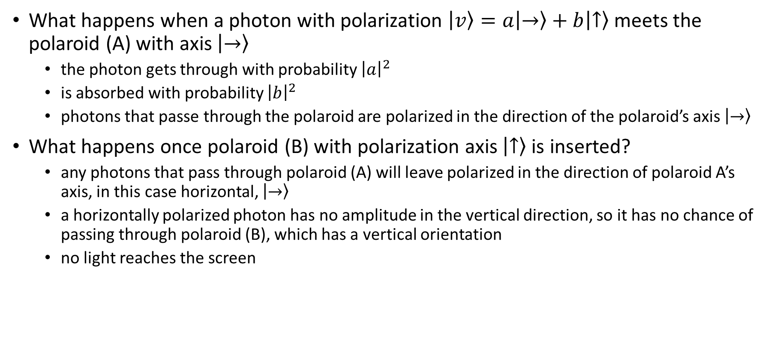
Photon’s polarization and qubits
What happens when a photon with polarization $\left|v\right\rangle =a\left|→\right\rangle +b\left|↑\right\rangle$ meets the polaroid (A) with axis $\left|→\right\rangle$
the photon gets through with probability ${\left|a\right|}^{2}$
is absorbed with probability ${\left|b\right|}^{2}$
photons that passe through the polaroid are polarized in the direction of the polaroid’s axis $\left|→\right\rangle$
What happens once polaroid (B) with polarization axis $\left|↑\right\rangle$ is inserted?
any photons that pass through polaroid (A) will leave polarized in the direction of polaroid A’s axis, in this case horizontal, $\left|→\right\rangle$
a horizontally polarized photon has no amplitude in the vertical direction, so it has no chance of passing through polaroid (B), which has a vertical orientation
no light reaches the screen

Slide 14
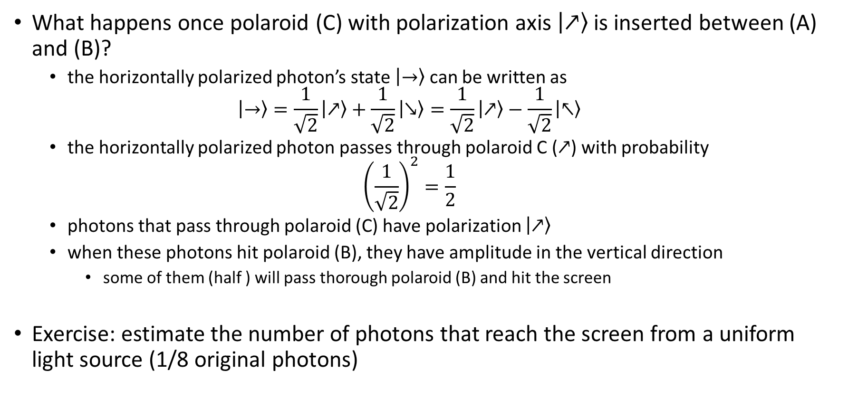
Photon’s polarization and qubits
What happens once polaroid (C) with polarization axis $\left|↗\right\rangle$ is inserted between (A) and (B)?
the horizontally polarized photon’s state $\left|→\right\rangle$ can be written as $\left|→\right\rangle =\frac{1}{\sqrt{2}}\left|↗\right\rangle +\frac{1}{\sqrt{2}}\left|↘\right\rangle =\frac{1}{\sqrt{2}}\left|↗\right\rangle −\frac{1}{\sqrt{2}}\left|↖\right\rangle$
the horizontally polarized photon passes through polaroid C ($↗$) with probability ${\left(\frac{1}{\sqrt{2}}\right)}^{2}=\frac{1}{2}$
photons that pass through polaroid (C) have polarization $\left|↗\right\rangle$
when these photons hit polaroid (B), they have amplitude in the vertical direction
some of them (half ) will pass thorough polaroid (B) and hit the screen
Exercise: estimate the number of photons that reach the screen from a uniform light source (1/8 original photons)

Slide 15
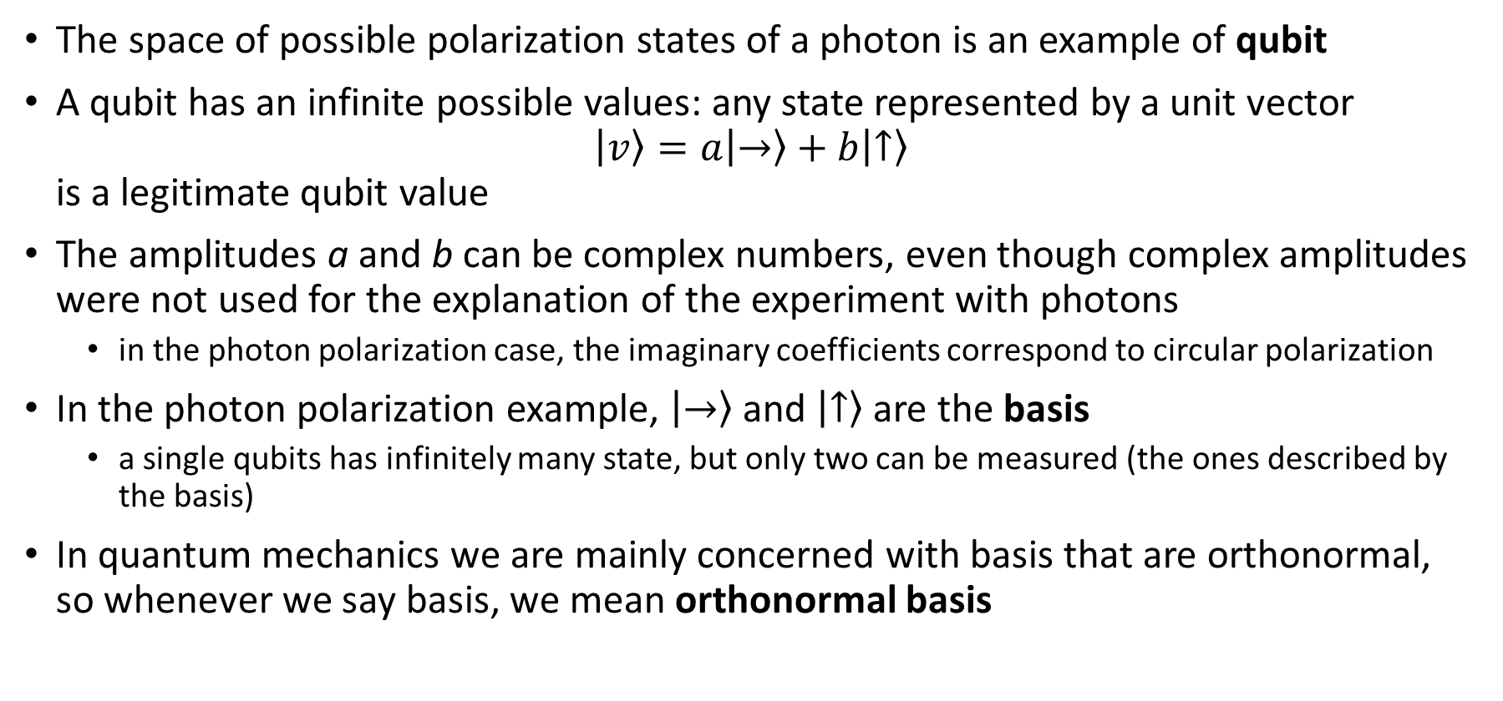
Single qubits
The space of possible polarization states of a photon is an example of qubit
A qubit has an infinite possible values: any state represented by a unit vector $\left|v\right\rangle =a\left|→\right\rangle +b\left|↑\right\rangle$ is a legitimate qubit value
The amplitudes a and b can be complex numbers, even though complex amplitudes were not used for the explanation of the experiment with photons
in the photon polarization case, the imaginary coefficients correspond to circular polarization
In the photon polarization example, $\left|→\right\rangle$ and $\left|↑\right\rangle$ are the basis
a single qubits has infinitely many state, but only two can be measured (the ones described by the basis)
In quantum mechanics we are mainly concerned with basis that are orthonormal, so whenever we say basis, we mean orthonormal basis

Slide 16

Single qubits basis
The most used basis are the standard basis denoted with labels $\left|0\right\rangle$ and $\left|1\right\rangle$
$\left|0\right\rangle =\left(\begin{matrix}1 \\ 0\end{matrix}\right)$
$\left|1\right\rangle =\left(\begin{matrix}0 \\ 1\end{matrix}\right)$
Another set of useful basis are the Hadamard basis
$\left|+\right\rangle =\left(\begin{matrix}\frac{1}{\sqrt{2}} \\ \frac{1}{\sqrt{2}}\end{matrix}\right)$
$\left|−\right\rangle =\left(\begin{matrix}\frac{1}{\sqrt{2}} \\ −\frac{1}{\sqrt{2}}\end{matrix}\right)$

Slide 17

Exercise
How to pass from one basis (standard) to another one (Hadamard)
Standard: $a\left|0\right\rangle +b\left|1\right\rangle =a\left(\begin{matrix}1 \\ 0\end{matrix}\right)+b\left(\begin{matrix}0 \\ 1\end{matrix}\right)=\left(\begin{matrix}a \\ b\end{matrix}\right)$
Hadamard: $x\left|+\right\rangle +y\left|−\right\rangle =x\left(\begin{matrix}\frac{1}{\sqrt{2}} \\ \frac{1}{\sqrt{2}}\end{matrix}\right)+y\left(\begin{matrix}\frac{1}{\sqrt{2}} \\ −\frac{1}{\sqrt{2}}\end{matrix}\right)=\left(\begin{matrix}\frac{\left(x+y\right)}{\sqrt{2}} \\ \frac{\left(x­−y\right)}{\sqrt{2}}\end{matrix}\right)$
$a=\frac{\left(x+y\right)}{\sqrt{2}}$
$b=\frac{\left(x−y\right)}{\sqrt{2}}$
$x=\frac{\left(a+b\right)}{\sqrt{2}}$
$y=\frac{\left(a−b\right)}{\sqrt{2}}$

Slide 18
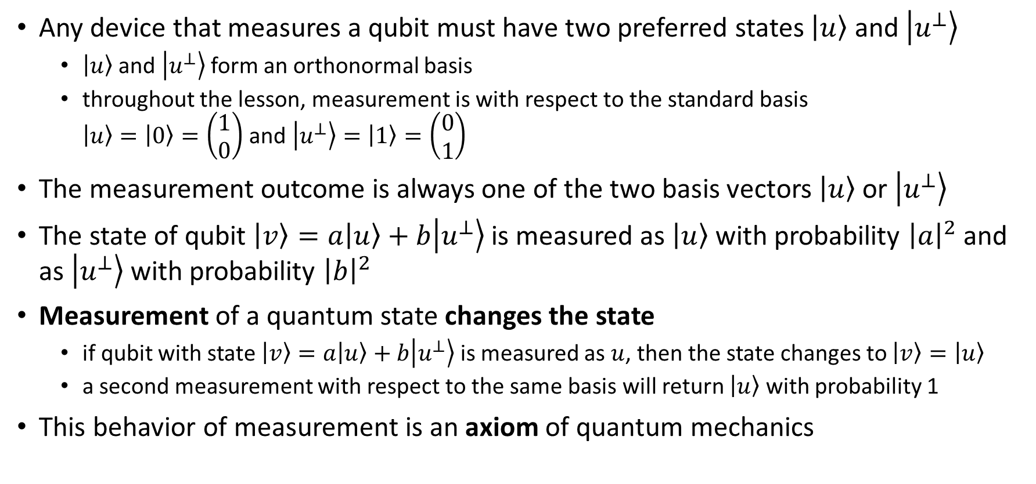
Single qubits measurement
Any device that measures a qubit must have two preferred states $\left|u\right\rangle$ and $\left|u^{⊥}\right\rangle$
$\left|u\right\rangle$ and $\left|u^{⊥}\right\rangle$form an orthonormal basis
throughout the lesson, measurement is with respect to the standard basis $\left|u\right\rangle =\left|0\right\rangle =\left(\begin{matrix}1 \\ 0\end{matrix}\right)$ and $\left|u^{⊥}\right\rangle =\left|1\right\rangle =\left(\begin{matrix}0 \\ 1\end{matrix}\right)$
The measurement outcome is always one of the two basis vectors $\left|u\right\rangle$ or $\left|u^{⊥}\right\rangle$
The state of qubit $\left|v\right\rangle =a\left|u\right\rangle +b\left|u^{⊥}\right\rangle$ is measured as $\left|u\right\rangle$ with probability ${\left|a\right|}^{2}$ and as $\left|u^{⊥}\right\rangle$ with probability ${\left|b\right|}^{2}$
Measurement of a quantum state changes the state
if qubit with state $\left|v\right\rangle =a\left|u\right\rangle +b\left|u^{⊥}\right\rangle$ is measured as $u$, then the state changes to $\left|v\right\rangle =\left|u\right\rangle$
a second measurement with respect to the same basis will return $\left|u\right\rangle$ with probability 1
This behavior of measurement is an axiom of quantum mechanics

Slide 19
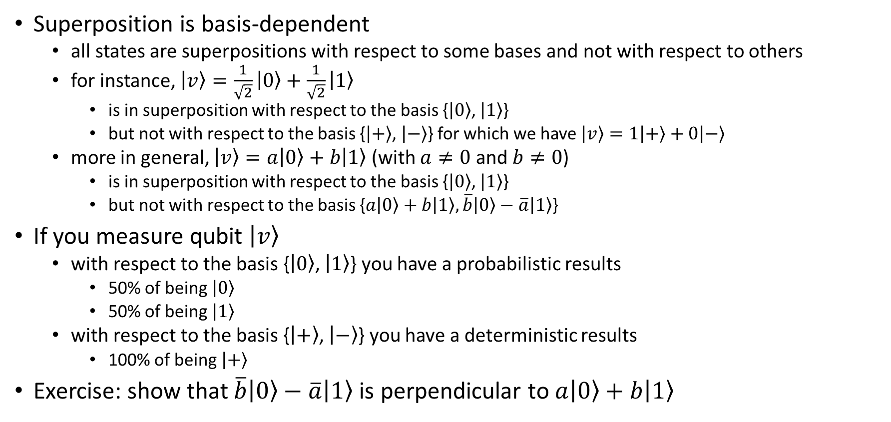
Single qubits measurement
Superposition is basis-dependent
all states are superpositions with respect to some bases and not with respect to others
for instance, $\left|v\right\rangle =\frac{1}{\sqrt{2}}\left|0\right\rangle +\frac{1}{\sqrt{2}}\left|1\right\rangle$
is in superposition with respect to the basis {$\left|0\right\rangle$, $\left|1\right\rangle$}
but not with respect to the basis {$\left|+\right\rangle$, $\left|−\right\rangle$} for which we have $\left|v\right\rangle =1\left|+\right\rangle +0\left|−\right\rangle$
more in general, $\left|v\right\rangle =a\left|0\right\rangle +b\left|1\right\rangle$ (with $a≠0$ and $b≠0$)
is in superposition with respect to the basis {$\left|0\right\rangle$, $\left|1\right\rangle$}
but not with respect to the basis {$a\left|0\right\rangle +b\left|1\right\rangle ,\overline{b}\left|0\right\rangle −\overline{a}\left|1\right\rangle$}
If you measure qubit $\left|v\right\rangle$
with respect to the basis {$\left|0\right\rangle$, $\left|1\right\rangle$} you have a probabilistic results
50% of being $\left|0\right\rangle$
50% of being $\left|1\right\rangle$
with respect to the basis {$\left|+\right\rangle$, $\left|−\right\rangle$} you have a deterministic results
100% of being $\left|+\right\rangle$
Exercise: show that $\overline{b}\left|0\right\rangle −\overline{a}\left|1\right\rangle$ is perpendicular to $a\left|0\right\rangle +b\left|1\right\rangle$

Slide 20
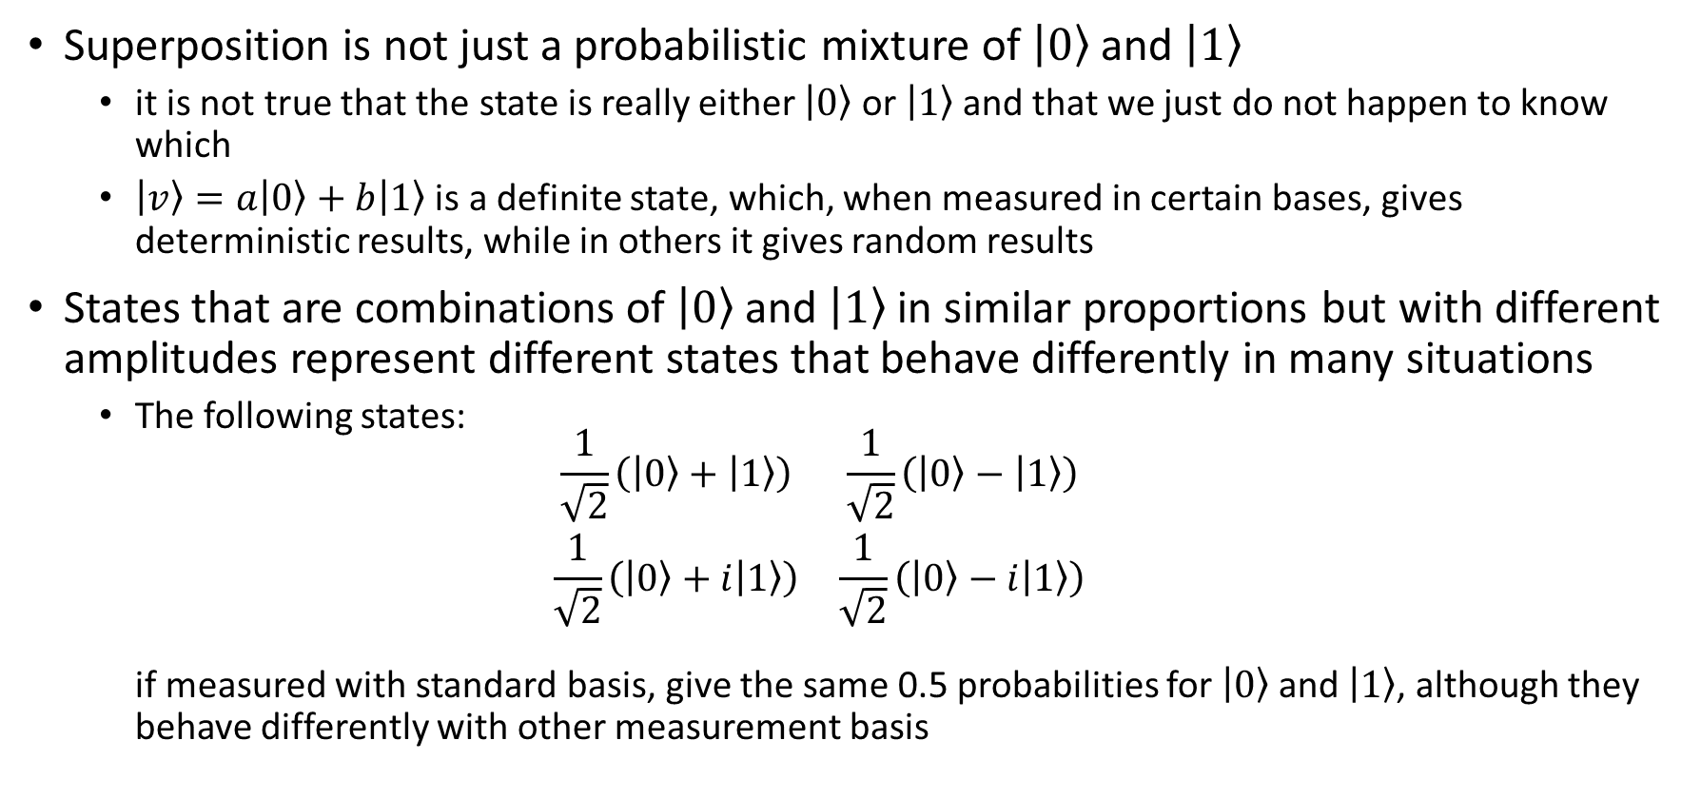
Interpretation of superposition
Superposition is not just a probabilistic mixture of $\left|0\right\rangle$ and $\left|1\right\rangle$
it is not true that the state is really either $\left|0\right\rangle$ or $\left|1\right\rangle$and that we just do not happen to know which
$\left|v\right\rangle =a\left|0\right\rangle +b\left|1\right\rangle$ is a definite state, which, when measured in certain bases, gives deterministic results, while in others it gives random results
States that are combinations of $\left|0\right\rangle$and $\left|1\right\rangle$in similar proportions but with different amplitudes represent different states that behave differently in many situations
The following states: $\begin{matrix}\frac{1}{\sqrt{2}}\left(\left|0\right\rangle +\left|1\right\rangle \right) & \frac{1}{\sqrt{2}}\left(\left|0\right\rangle −\left|1\right\rangle \right) \\ \frac{1}{\sqrt{2}}\left(\left|0\right\rangle +i\left|1\right\rangle \right) & \frac{1}{\sqrt{2}}\left(\left|0\right\rangle −i\left|1\right\rangle \right)\end{matrix}$ if measured with standard basis, give the same 0.5 probabilities for $\left|0\right\rangle$and $\left|1\right\rangle$, although they behave differently with other measurement basis

Slide 21
Information carried by single qubits
Qubits can take one of infinitely many states
one might hope that a single qubit could store lots of classical information
a single measurement yields at most a single classical bit of information
because measurement changes the state, one cannot make two measurements on the original state of a qubit
quantum state cannot be cloned: it is not possible to measure a qubit’s state twice, even indirectly by copying the qubit’s state and measuring the copy

Slide 22
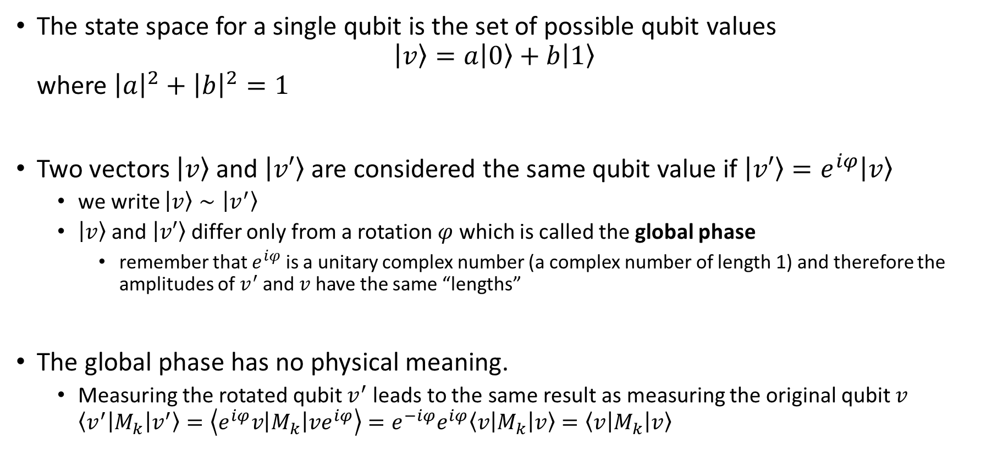
The State Space of a Single-Qubit System
The state space for a single qubit is the set of possible qubit values $\left|v\right\rangle =a\left|0\right\rangle +b\left|1\right\rangle$ where ${\left|a\right|}^{2}+{\left|b\right|}^{2}=1$
Two vectors $\left|v\right\rangle$ and $\left|v′\right\rangle$ are considered the same qubit value if $\left|v′\right\rangle =e^{iφ}\left|v\right\rangle$
we write $\left|v\right\rangle ∼\left|v^{′}\right\rangle$
$\left|v\right\rangle$ and $\left|v′\right\rangle$ differ only from a rotation $φ$ which is called the global phase
remember that $e^{iφ}$ is a unitary complex number (a complex number of length 1) and therefore the amplitudes of $v^{′}$and $v$ have the same “lengths”
The global phase has no physical meaning.
Measuring the rotated qubit $v^{′}$leads to the same result as measuring the original qubit $v$ $\left\langle v^{′}\left|M_{k}\right|v^{′}\right\rangle =\left\langle e^{iφ}v\left|M_{k}\right|ve^{iφ}\right\rangle =e^{−iφ}e^{iφ}\left\langle v\left|M_{k}\right|v\right\rangle =\left\langle v\left|M_{k}\right|v\right\rangle$

Slide 23




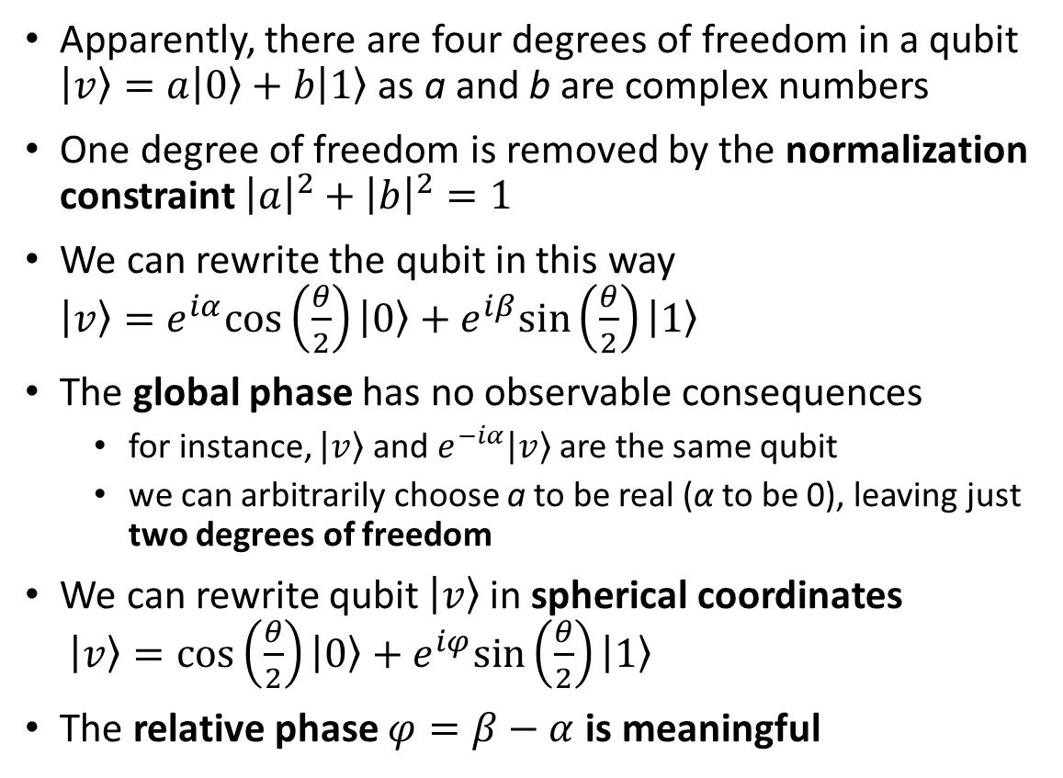






Bloch sphere representation of qubit
z
Apparently, there are four degrees of freedom in a qubit $\left|v\right\rangle =a\left|0\right\rangle +b\left|1\right\rangle$ as a and b are complex numbers
One degree of freedom is removed by the normalization constraint ${\left|a\right|}^{2}+{\left|b\right|}^{2}=1$
We can rewrite the qubit in this way $\left|v\right\rangle =e^{iα}cos\left(\frac{θ}{2}\right)\left|0\right\rangle +e^{iβ}sin\left(\frac{θ}{2}\right)\left|1\right\rangle$
The global phase has no observable consequences
for instance, $\left|v\right\rangle$ and $e^{−iα}\left|v\right\rangle$ are the same qubit
we can arbitrarily choose a to be real (α to be 0), leaving just two degrees of freedom
We can rewrite qubit $\left|v\right\rangle$in spherical coordinates $\left|v\right\rangle =\cos\left(\frac{θ}{2}\right)\left|0\right\rangle +e^{iφ}sin\left(\frac{θ}{2}\right)\left|1\right\rangle$
The relative phase $φ=β−α$ is meaningful
$$\left|0\right\rangle$$
$$\left|v\right\rangle$$
$$θ$$
$$\left|−\right\rangle$$
$$\left|i\right\rangle$$
$$\left|−i\right\rangle$$
$$\left|+\right\rangle$$
$$φ$$
y
x
$$\left|1\right\rangle$$

Slide 24
Operations on Qubits
Logic Gates
building blocks for a quantum circuit
operate on single qubits or on sets of qubits
change the state of the qubits
are “reversible”
Measurement
is an irreversible operation in which information is gained about the state of a single qubit
collapse the state of the qubit (superposition and entanglement are lost)
Initialization
to a known value, often |0⟩
can be implemented as a measurement
collapses the quantum state (exactly like with measurement)

Slide 25
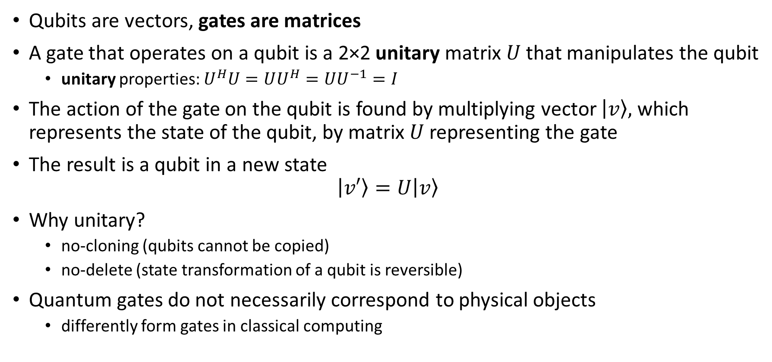
Quantum Logic Gates
Qubits are vectors, gates are matrices
A gate that operates on a qubit is a 2×2 unitary matrix $U$that manipulates the qubit
unitary properties: $U^{H}U=UU^{H}=UU^{−1}=I$
The action of the gate on the qubit is found by multiplying vector $\left|v\right\rangle ,$ which represents the state of the qubit, by matrix $U$representing the gate
The result is a qubit in a new state $\left|v′\right\rangle =U\left|v\right\rangle$
Why unitary?
no-cloning (qubits cannot be copied)
no-delete (state transformation of a qubit is reversible)
Quantum gates do not necessarily correspond to physical objects
differently form gates in classical computing

Slide 26
No-cloning principle: why it matters?
Cloning violates quantum mechanic principles
no-signaling (instantaneous transfer of information)
put infinite amount of info inside a qubit
Makes quantum error correction harder

Slide 27
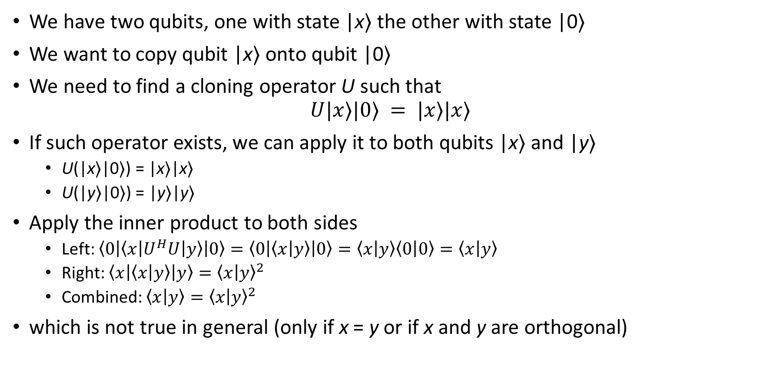
No-cloning principle: demonstration
We have two qubits, one with state |x⟩ the other with state |0⟩
We want to copy qubit |x⟩ onto qubit |0⟩
We need to find a cloning operator U such that $U|x⟩|0⟩ = |x⟩|x⟩$
If such operator exists, we can apply it to both qubits |x⟩ and |y⟩
U(|x⟩|0⟩) = |x⟩|x⟩
U(|y⟩|0⟩) = |y⟩|y⟩
Apply the inner product to both sides
Left: $\left\langle 0\left|\left\langle x\left|U^{H}U\right|y\right\rangle \right|0\right\rangle =\left\langle 0\left|\left\langle x | y\right\rangle \right|0\right\rangle =\left\langle x | y\right\rangle \left\langle 0 | 0\right\rangle =\left\langle x | y\right\rangle$
Right: $\left\langle x\left|\left\langle x | y\right\rangle \right|y\right\rangle ={\left\langle x | y\right\rangle }^{2}$
Combined: $\left\langle x | y\right\rangle ={\left\langle x | y\right\rangle }^{2}$
which is not true in general (only if x = y or if x and y are orthogonal)

Slide 28

No-deleting principle
Demonstration similar to no-cloning
We need to find a deleting operator U such that $U|x⟩|x⟩ = |x⟩|0⟩$
which is not true in general (only if x = y or if x and y are orthogonal)

Slide 29
Quantum Logic Gates
Single Qubit Gates
Multiple Qubit Gates

Slide 30










Single-qubit Gates
z
Identity: $I=\left[\begin{matrix}1 & 0 \\ 0 & 1\end{matrix}\right]$
Not: $X=\left[\begin{matrix}0 & 1 \\ 1 & 0\end{matrix}\right]$
Phase Flip: $Z=\left[\begin{matrix}1 & 0 \\ 0 & −1\end{matrix}\right]$
Hadamar: $H=\frac{1}{\sqrt{2}}\left[\begin{matrix}1 & 1 \\ 1 & −1\end{matrix}\right]$
$$\left|0\right\rangle$$
I
$$\left|v\right\rangle$$
$$θ$$
$$\left|−\right\rangle$$
$$\left|i\right\rangle$$
$$\left|−i\right\rangle$$
$$φ$$
y
$$\left|+\right\rangle$$
Z
x
H
$$\left|1\right\rangle$$

Slide 31

Single-qubit Gates: Identity
z
Identity: $I=\left[\begin{matrix}1 & 0 \\ 0 & 1\end{matrix}\right]$
$\left|v\right\rangle =I\left|v\right\rangle$
apparently useless, but it is not
important with multiple-qubits circuits
$$\left|0\right\rangle$$
$$\left|v\right\rangle$$
$$θ$$
$$\left|−\right\rangle$$
$$\left|i\right\rangle$$
$$\left|−i\right\rangle$$
$$φ$$
y
$$\left|+\right\rangle$$
x
$$\left|1\right\rangle$$

Slide 32
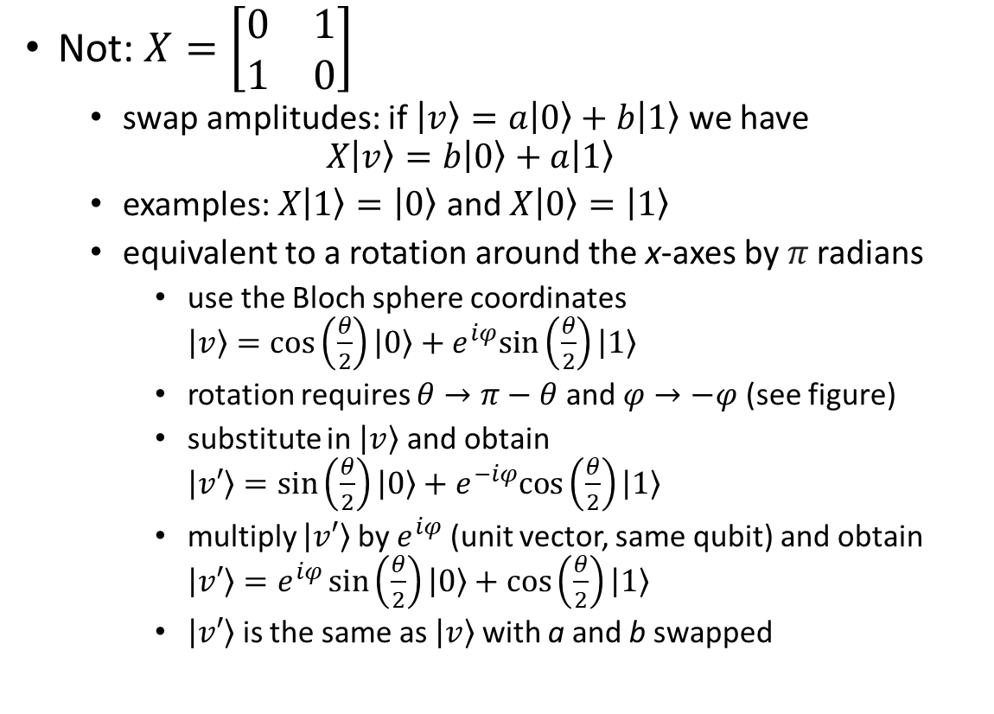
Single-qubit Gates: Not (X)
z
Not: $X=\left[\begin{matrix}0 & 1 \\ 1 & 0\end{matrix}\right]$
swap amplitudes: if $\left|v\right\rangle =a\left|0\right\rangle +b\left|1\right\rangle$ we have $X\left|v\right\rangle =b\left|0\right\rangle +a\left|1\right\rangle$
examples: $X\left|1\right\rangle =\left|0\right\rangle$ and $X\left|0\right\rangle =\left|1\right\rangle$
equivalent to a rotation around the x-axes by 𝜋 radians
use the Bloch sphere coordinates $\left|v\right\rangle =\cos\left(\frac{θ}{2}\right)\left|0\right\rangle +e^{iφ}sin\left(\frac{θ}{2}\right)\left|1\right\rangle$
rotation requires $θ→π−θ$ and $φ→−φ$ (see figure)
substitute in $\left|v\right\rangle$ and obtain $\left|v′\right\rangle =\sin\left(\frac{θ}{2}\right)\left|0\right\rangle +e^{−iφ}cos\left(\frac{θ}{2}\right)\left|1\right\rangle$
multiply $\left|v′\right\rangle$ by $e^{iφ}$ (unit vector, same qubit) and obtain $\left|v′\right\rangle =e^{iφ}\sin\left(\frac{θ}{2}\right)\left|0\right\rangle +\cos\left(\frac{θ}{2}\right)\left|1\right\rangle$
$\left|v′\right\rangle$ is the same as $\left|v\right\rangle$with a and b swapped
$$\left|0\right\rangle$$
$$\left|v\right\rangle$$
$$θ$$
$$\left|−\right\rangle$$
$$\left|i\right\rangle$$
$$\left|−i\right\rangle$$
$$φ$$
y
$$\left|+\right\rangle$$
x
$$\left|1\right\rangle$$

Slide 33
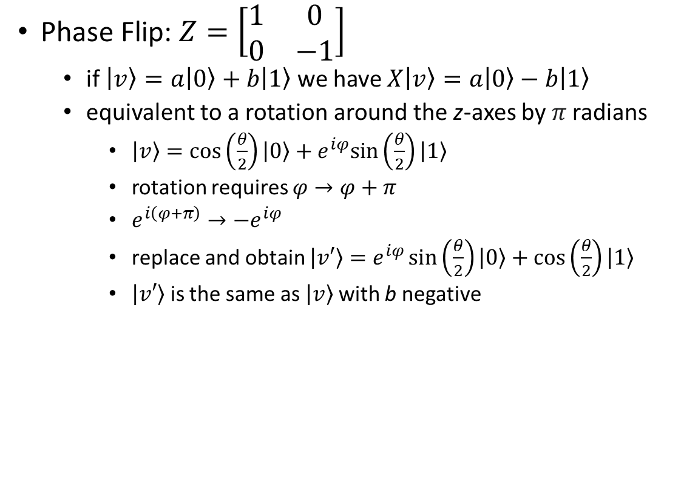
Single-qubit Gates: Phase Flip (Z)
z
Phase Flip: $Z=\left[\begin{matrix}1 & 0 \\ 0 & −1\end{matrix}\right]$
if $\left|v\right\rangle =a\left|0\right\rangle +b\left|1\right\rangle$ we have $X\left|v\right\rangle =a\left|0\right\rangle −b\left|1\right\rangle$
equivalent to a rotation around the z-axes by 𝜋 radians
$\left|v\right\rangle =\cos\left(\frac{θ}{2}\right)\left|0\right\rangle +e^{iφ}sin\left(\frac{θ}{2}\right)\left|1\right\rangle$
rotation requires $φ→φ+π$
$e^{i\left(φ+π\right)}→{−e}^{iφ}$
replace and obtain $\left|v′\right\rangle =e^{iφ}\sin\left(\frac{θ}{2}\right)\left|0\right\rangle +\cos\left(\frac{θ}{2}\right)\left|1\right\rangle$
$\left|v′\right\rangle$ is the same as $\left|v\right\rangle$with b negative
$$\left|0\right\rangle$$
$$\left|v\right\rangle$$
$$θ$$
$$\left|−\right\rangle$$
$$\left|i\right\rangle$$
$$\left|−i\right\rangle$$
$$φ$$
y
$$\left|+\right\rangle$$
x
$$\left|1\right\rangle$$

Slide 34
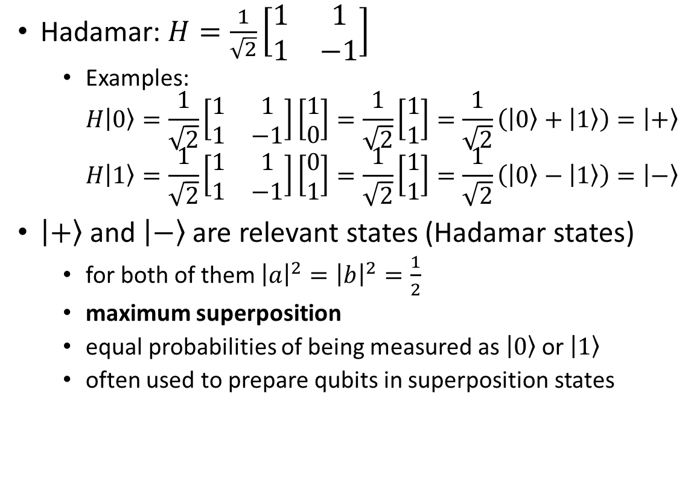
Single-qubit Gates: Hadamar (H)
z
Hadamar: $H=\frac{1}{\sqrt{2}}\left[\begin{matrix}1 & 1 \\ 1 & −1\end{matrix}\right]$
Examples: $H\left|0\right\rangle =\frac{1}{\sqrt{2}}\left[\begin{matrix}1 & 1 \\ 1 & −1\end{matrix}\right]\left[\begin{matrix}1 \\ 0\end{matrix}\right]=\frac{1}{\sqrt{2}}\left[\begin{matrix}1 \\ 1\end{matrix}\right]=\frac{1}{\sqrt{2}}\left(\left|0\right\rangle +\left|1\right\rangle \right)=\left|+\right\rangle$ $H\left|1\right\rangle =\frac{1}{\sqrt{2}}\left[\begin{matrix}1 & 1 \\ 1 & −1\end{matrix}\right]\left[\begin{matrix}0 \\ 1\end{matrix}\right]=\frac{1}{\sqrt{2}}\left[\begin{matrix}1 \\ 1\end{matrix}\right]=\frac{1}{\sqrt{2}}\left(\left|0\right\rangle −\left|1\right\rangle \right)=\left|−\right\rangle$
$\left|+\right\rangle$ and $\left|−\right\rangle$ are relevant states (Hadamar states)
for both of them ${\left|a\right|}^{2}={\left|b\right|}^{2}=\frac{1}{2}$
maximum superposition
equal probabilities of being measured as $\left|0\right\rangle$ or $\left|1\right\rangle$
often used to prepare qubits in superposition states
$$\left|0\right\rangle$$
$$\left|v\right\rangle$$
$$θ$$
$$\left|−\right\rangle$$
$$\left|i\right\rangle$$
$$\left|−i\right\rangle$$
$$φ$$
y
$$\left|+\right\rangle$$
x
$$\left|1\right\rangle$$

Slide 35


Single-qubit Quantum Circuits
A model for quantum computation
A sequence of
initializations of qubits to known values
gates
measurements
possibly other actions
Lines define the sequence of events
horizontal lines are qubits
objects connected by lines are operations (gates, measurements) performed on qubits
doubled lines are classical bits
lines are not physical connections
$$\left|v_{in}\right\rangle$$
A
B
$$\left|v_{out}\right\rangle$$

Slide 36

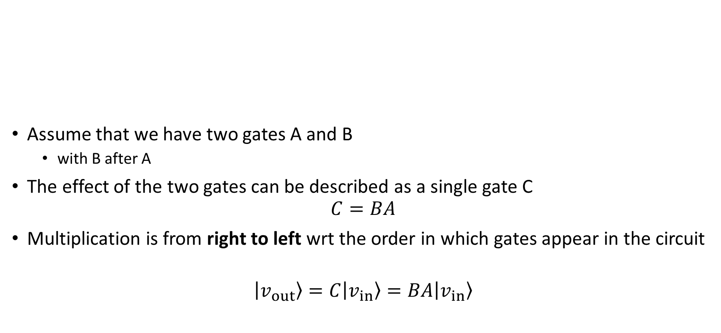



Single-qubit Quantum Circuits (Serial Gates)
A
B
Assume that we have two gates A and B
with B after A
The effect of the two gates can be described as a single gate C
$$C=BA$$
Multiplication is from right to left wrt the order in which gates appear in the circuit
$$\left|v_{out}\right\rangle =C\left|v_{in}\right\rangle =BA\left|v_{in}\right\rangle$$
$$\left|v_{in}\right\rangle$$
$$\left|v_{out}\right\rangle$$
$$\left|v_{in}\right\rangle$$
BA
$$\left|v_{out}\right\rangle$$

Slide 37

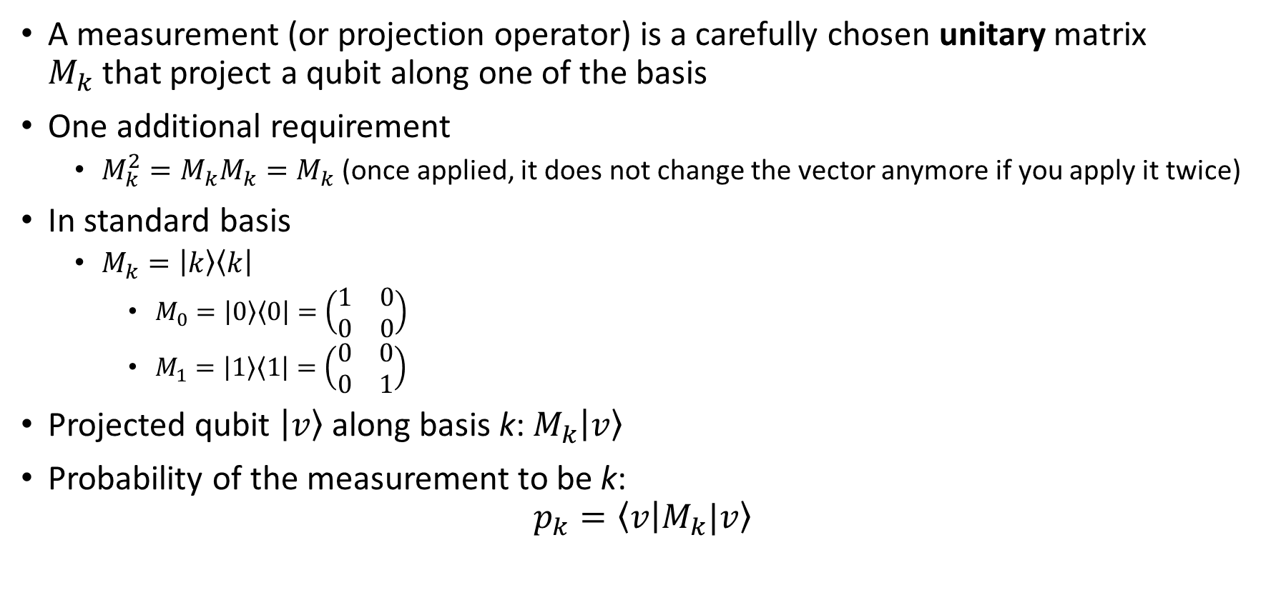



Measurement of Qubits
A measurement (or projection operator) is a carefully chosen unitary matrix $M_{k}$that project a qubit along one of the basis
One additional requirement
$M_{k}^{2}=M_{k}M_{k}=M_{k}$ (once applied, it does not change the vector anymore if you apply it twice)
In standard basis
$M_{k}=\left|k\right\rangle \left\langle k\right|$
$M_{0}=\left|0\right\rangle \left\langle 0\right|=\left(\begin{matrix}1 & 0 \\ 0 & 0\end{matrix}\right)$
$M_{1}=\left|1\right\rangle \left\langle 1\right|=\left(\begin{matrix}0 & 0 \\ 0 & 1\end{matrix}\right)$
Projected qubit $\left|v\right\rangle$along basis k: $M_{k}\left|v\right\rangle$
Probability of the measurement to be k: $p_{k}=\left\langle v | M_{k}|v\right\rangle$
$$\left|v\right\rangle$$
$$c$$
$$\left|v\right\rangle$$
$$c$$

Slide 38



Single-qubit Quantum Circuits: Example
$$\left|v_{out}\right\rangle =HH\left|0\right\rangle =\frac{1}{\sqrt{2}}\left[\begin{matrix}1 & 1 \\ 1 & −1\end{matrix}\right]\frac{1}{\sqrt{2}}\left[\begin{matrix}1 & 1 \\ 1 & −1\end{matrix}\right]\left[\begin{matrix}1 \\ 0\end{matrix}\right]=\frac{1}{2}\left[\begin{matrix}2 & 0 \\ 0 & 2\end{matrix}\right]\left[\begin{matrix}1 \\ 0\end{matrix}\right]=\left[\begin{matrix}1 \\ 0\end{matrix}\right]=\left|0\right\rangle$$
$$\left|0\right\rangle$$
H
H
$$\left|v_{out}\right\rangle$$

Slide 39


Single-qubit Quantum Circuits: Example
$$\left|v_{out}\right\rangle =HH\left|0\right\rangle =\frac{1}{\sqrt{2}}\left[\begin{matrix}1 & 1 \\ 1 & −1\end{matrix}\right]\frac{1}{\sqrt{2}}\left[\begin{matrix}1 & 1 \\ 1 & −1\end{matrix}\right]\left[\begin{matrix}1 \\ 0\end{matrix}\right]=\frac{1}{2}\left[\begin{matrix}2 & 0 \\ 0 & 2\end{matrix}\right]\left[\begin{matrix}1 \\ 0\end{matrix}\right]=\left[\begin{matrix}1 \\ 0\end{matrix}\right]=\left|0\right\rangle$$
$$\left|0\right\rangle$$
H
H
$$\left|v_{out}\right\rangle$$
$$\left|0\right\rangle$$
H
H
$$0$$

Slide 40
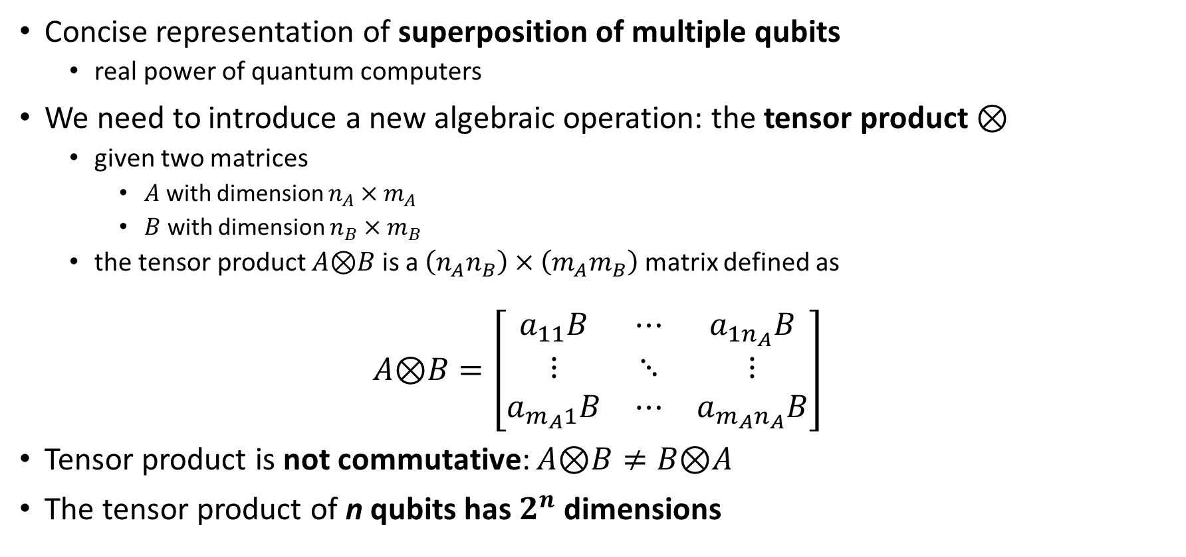
Multiple-Qubits States: Tensor Product
Concise representation of superposition of multiple qubits
real power of quantum computers
We need to introduce a new algebraic operation: the tensor product ⊗
given two matrices
$A$ with dimension $n_{A}×m_{A}$
$B$ with dimension $n_{B}×m_{B}$
the tensor product $A\text{⊗}B$ is a $\left({n_{A}n}_{B}\right)×\left({m_{A}m}_{B}\right)$ matrix defined as
$$A\text{⊗}B=\left[\begin{matrix}a_{11}B & ⋯ & a_{1n_{A}}B \\ ⋮ & ⋱ & ⋮ \\ a_{m_{A}1}B & ⋯ & a_{m_{A}n_{A}}B\end{matrix}\right]$$
Tensor product is not commutative: $A\text{⊗}B≠B\text{⊗}A$
The tensor product of n qubits has $2^{n}$ dimensions

Slide 41

Multiple-Qubits States: tensor product example
$$A=\left[\begin{matrix}2 \\ 3\end{matrix}\right]$$
$$B=\left[\begin{matrix}1 & 4 \\ 5 & 2\end{matrix}\right]$$
$$A\text{⊗}B=\left[\begin{matrix}2\left[\begin{matrix}1 & 4 \\ 5 & 2\end{matrix}\right] \\ 3\left[\begin{matrix}1 & 4 \\ 5 & 2\end{matrix}\right]\end{matrix}\right]=\left[\begin{matrix}2 & 8 \\ 10 & 4 \\ 3 & 12 \\ 15 & 6\end{matrix}\right]$$

Slide 42
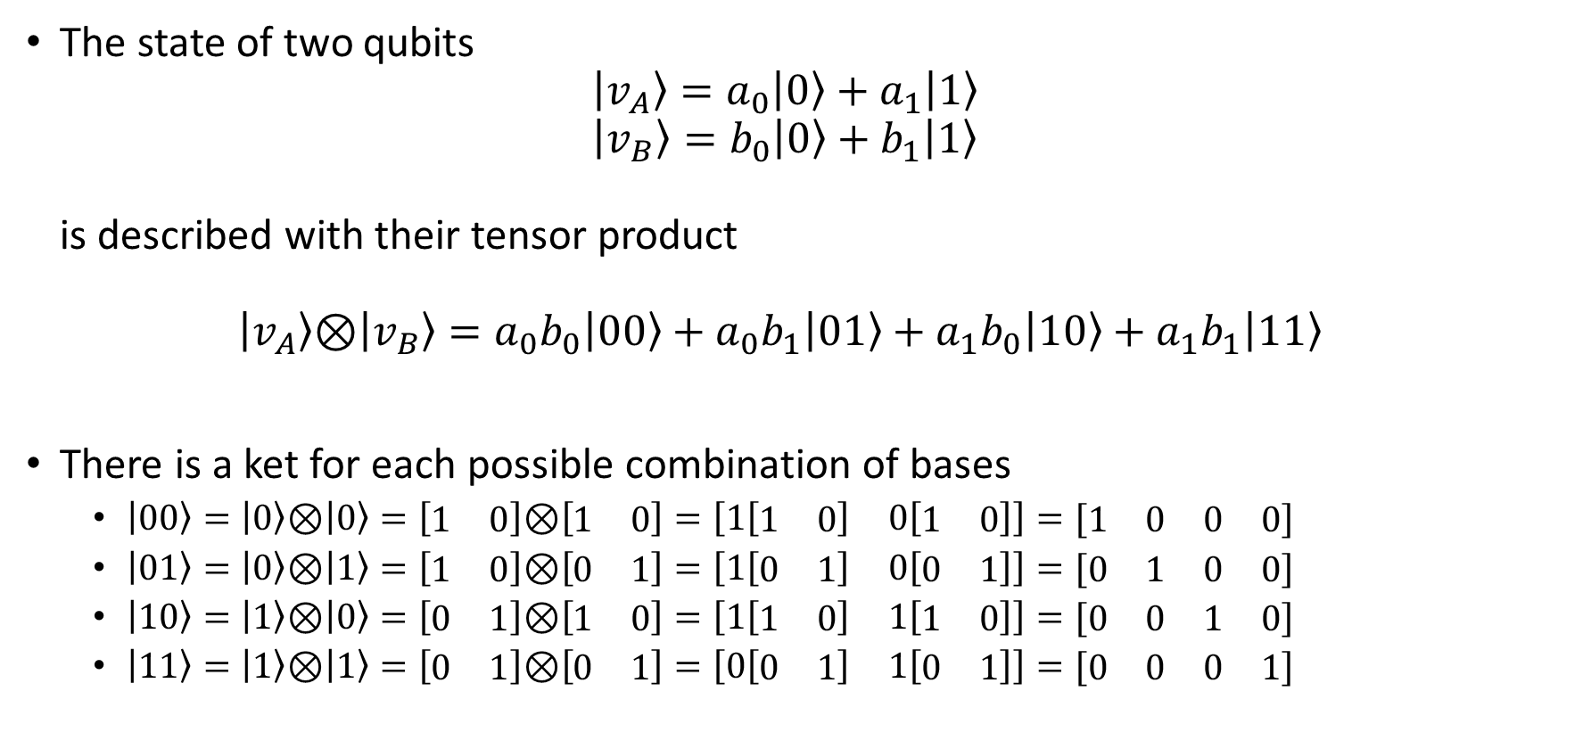


Multiple-Qubits States
The state of two qubits $\left|v_{A}\right\rangle =a_{0}\left|0\right\rangle +a_{1}\left|1\right\rangle$ $\left|v_{B}\right\rangle =b_{0}\left|0\right\rangle +b_{1}\left|1\right\rangle$ is described with their tensor product $\left|v_{A}\right\rangle \text{⊗}\left|v_{B}\right\rangle =a_{0}b_{0}\left|00\right\rangle +a_{0}b_{1}\left|01\right\rangle +a_{1}b_{0}\left|10\right\rangle +a_{1}b_{1}\left|11\right\rangle$
There is a ket for each possible combination of bases
$\left|00\right\rangle =\left|0\right\rangle \text{⊗}\left|0\right\rangle =\left[\begin{matrix}1 & 0\end{matrix}\right]\text{⊗}\left[\begin{matrix}1 & 0\end{matrix}\right]=\left[\begin{matrix}1\left[\begin{matrix}1 & 0\end{matrix}\right] & 0\left[\begin{matrix}1 & 0\end{matrix}\right]\end{matrix}\right]=[\begin{matrix}1 & 0 & 0 & 0\end{matrix}]$
$\left|01\right\rangle =\left|0\right\rangle \text{⊗}\left|1\right\rangle =\left[\begin{matrix}1 & 0\end{matrix}\right]\text{⊗}\left[\begin{matrix}0 & 1\end{matrix}\right]=\left[\begin{matrix}1\left[\begin{matrix}0 & 1\end{matrix}\right] & 0\left[\begin{matrix}0 & 1\end{matrix}\right]\end{matrix}\right]=[\begin{matrix}0 & 1 & 0 & 0\end{matrix}]$
$\left|10\right\rangle =\left|1\right\rangle \text{⊗}\left|0\right\rangle =\left[\begin{matrix}0 & 1\end{matrix}\right]\text{⊗}\left[\begin{matrix}1 & 0\end{matrix}\right]=\left[\begin{matrix}1\left[\begin{matrix}1 & 0\end{matrix}\right] & 1\left[\begin{matrix}1 & 0\end{matrix}\right]\end{matrix}\right]=[\begin{matrix}0 & 0 & 1 & 0\end{matrix}]$
$\left|11\right\rangle =\left|1\right\rangle \text{⊗}\left|1\right\rangle =\left[\begin{matrix}0 & 1\end{matrix}\right]\text{⊗}\left[\begin{matrix}0 & 1\end{matrix}\right]=\left[\begin{matrix}0\left[\begin{matrix}0 & 1\end{matrix}\right] & 1\left[\begin{matrix}0 & 1\end{matrix}\right]\end{matrix}\right]=[\begin{matrix}0 & 0 & 0 & 1\end{matrix}]$
The opposite is not always true!!

Slide 43
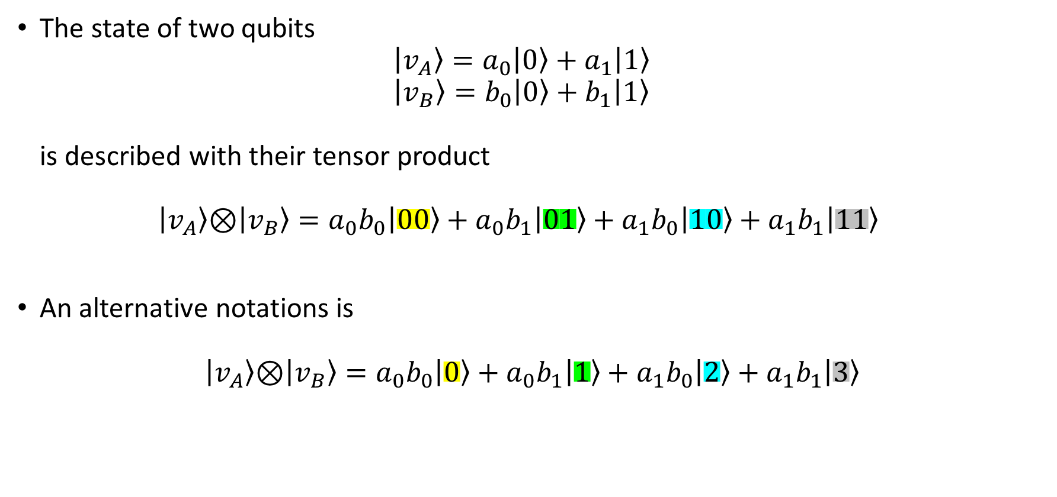
Multiple-Qubits States
The state of two qubits $\left|v_{A}\right\rangle =a_{0}\left|0\right\rangle +a_{1}\left|1\right\rangle$ $\left|v_{B}\right\rangle =b_{0}\left|0\right\rangle +b_{1}\left|1\right\rangle$ is described with their tensor product $\left|v_{A}\right\rangle \text{⊗}\left|v_{B}\right\rangle =a_{0}b_{0}\left|00\right\rangle +a_{0}b_{1}\left|01\right\rangle +a_{1}b_{0}\left|10\right\rangle +a_{1}b_{1}\left|11\right\rangle$
An alternative notations is
$$\left|v_{A}\right\rangle \text{⊗}\left|v_{B}\right\rangle =a_{0}b_{0}\left|0\right\rangle +a_{0}b_{1}\left|1\right\rangle +a_{1}b_{0}\left|2\right\rangle +a_{1}b_{1}\left|3\right\rangle$$

Slide 44
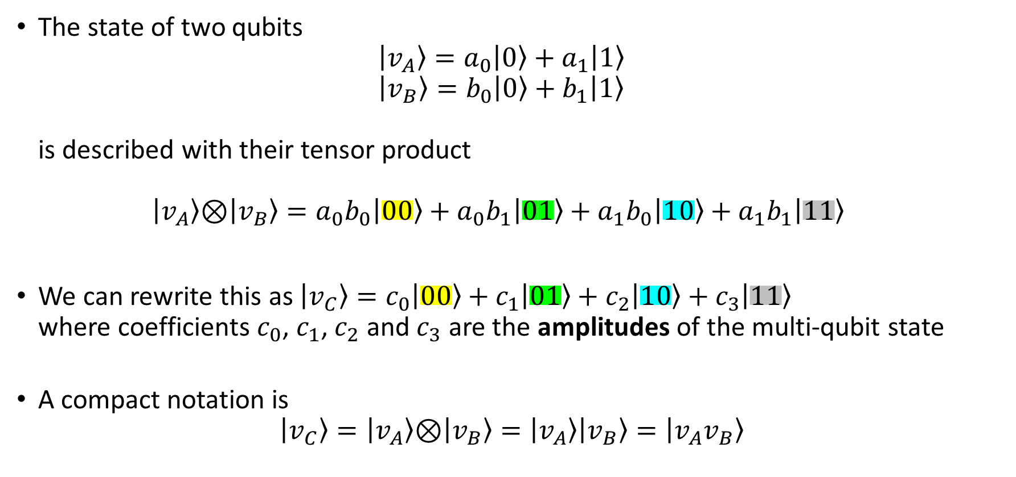
Multiple-Qubits States
The state of two qubits $\left|v_{A}\right\rangle =a_{0}\left|0\right\rangle +a_{1}\left|1\right\rangle$ $\left|v_{B}\right\rangle =b_{0}\left|0\right\rangle +b_{1}\left|1\right\rangle$ is described with their tensor product $\left|v_{A}\right\rangle \text{⊗}\left|v_{B}\right\rangle =a_{0}b_{0}\left|00\right\rangle +a_{0}b_{1}\left|01\right\rangle +a_{1}b_{0}\left|10\right\rangle +a_{1}b_{1}\left|11\right\rangle$
We can rewrite this as $\left|v_{C}\right\rangle =c_{0}\left|00\right\rangle +c_{1}\left|01\right\rangle +c_{2}\left|10\right\rangle +c_{3}\left|11\right\rangle$ where coefficients $c_{0}$, $c_{1}$, $c_{2}$ and $c_{3}$ are the amplitudes of the multi-qubit state
A compact notation is $\left|v_{C}\right\rangle =\left|v_{A}\right\rangle \text{⊗}\left|v_{B}\right\rangle =\left|v_{A}\right\rangle \left|v_{B}\right\rangle =\left|v_{A}v_{B}\right\rangle$

Slide 45
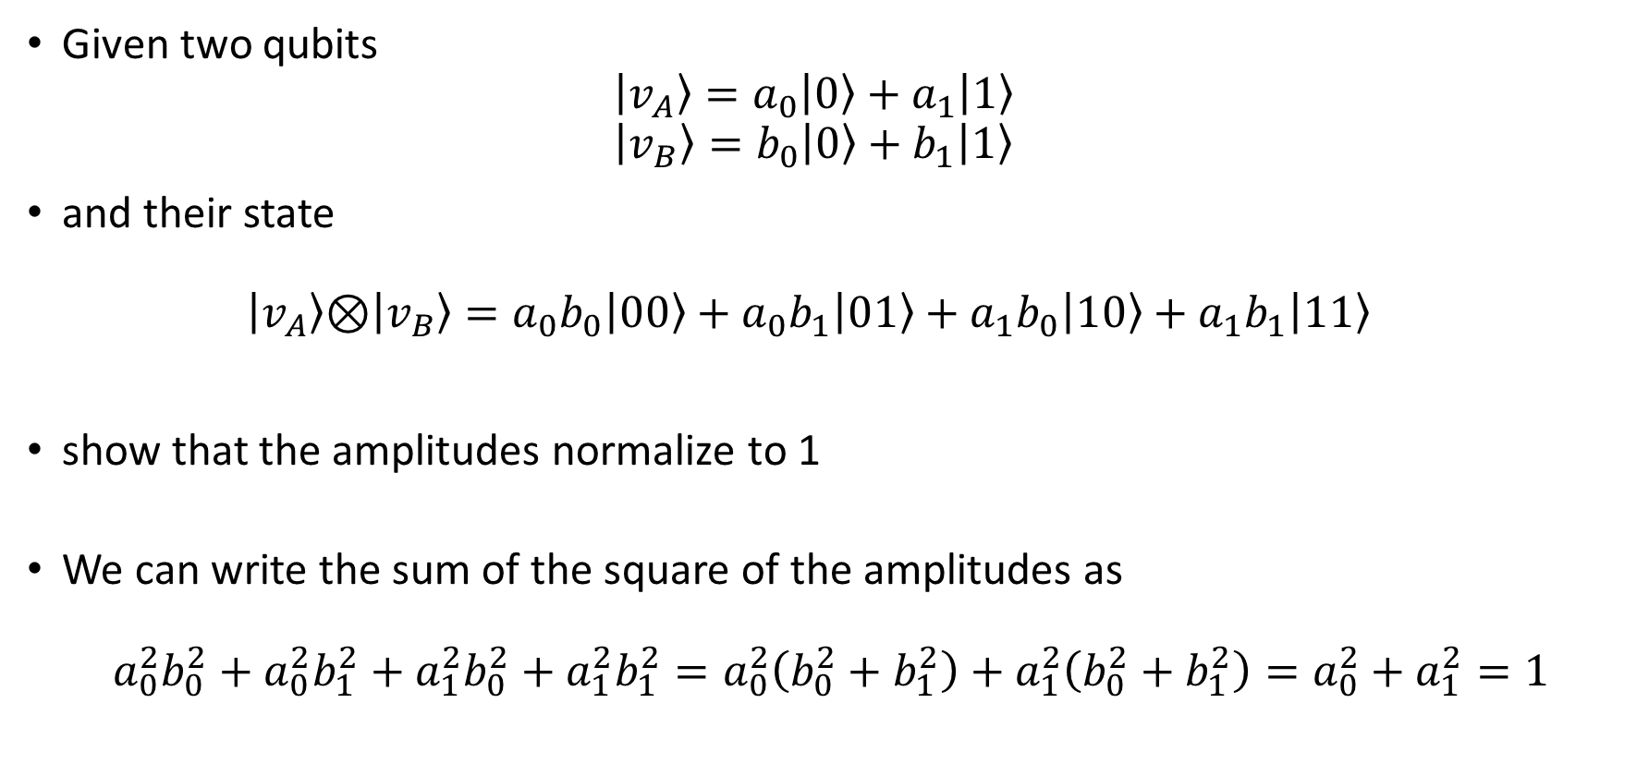
Multiple-Qubits States: exercise
Given two qubits $\left|v_{A}\right\rangle =a_{0}\left|0\right\rangle +a_{1}\left|1\right\rangle$ $\left|v_{B}\right\rangle =b_{0}\left|0\right\rangle +b_{1}\left|1\right\rangle$
and their state $\left|v_{A}\right\rangle \text{⊗}\left|v_{B}\right\rangle =a_{0}b_{0}\left|00\right\rangle +a_{0}b_{1}\left|01\right\rangle +a_{1}b_{0}\left|10\right\rangle +a_{1}b_{1}\left|11\right\rangle$
show that the amplitudes normalize to 1
We can write the sum of the square of the amplitudes as
$$a_{0}^{2}b_{0}^{2}+a_{0}^{2}b_{1}^{2}+a_{1}^{2}b_{0}^{2}+a_{1}^{2}b_{1}^{2}=a_{0}^{2}\left(b_{0}^{2}+b_{1}^{2}\right)+a_{1}^{2}\left(b_{0}^{2}+b_{1}^{2}\right)=a_{0}^{2}+a_{1}^{2}=1$$

Slide 46



Multiple-Qubits Circuits (Parallel Gates)
$$\left|v_{A}\right\rangle$$
A
$$\left|v_{C}\right\rangle =?$$
$$\left|v_{B}\right\rangle$$
B

Slide 47





Multiple-Qubits Circuits (Parallel Gates)
$$\left|v_{A}\right\rangle$$
A
$$A\left|v_{A}\right\rangle$$
$$\left(A\left|v_{A}\right\rangle \right)\text{⊗}\left(B\left|v_{B}\right\rangle \right)$$
$$\left|v_{B}\right\rangle$$
B
$$B\left|v_{B}\right\rangle$$
$$\left|v_{A}\right\rangle$$
A
$$\left|v_{C}\right\rangle =?$$
$$\left|v_{B}\right\rangle$$
B

Slide 48



Multiple-Qubits Circuits (Parallel Gates)
$$\left|v_{A}\right\rangle$$
A
$$A\left|v_{A}\right\rangle$$
$$\left(A\left|v_{A}\right\rangle \right)\text{⊗}\left(B\left|v_{B}\right\rangle \right)$$
$$\left|v_{B}\right\rangle$$
B
$$B\left|v_{B}\right\rangle$$
$$\left|v_{A}\right\rangle$$
A
$$\left|v_{C}\right\rangle =?$$
$$\left|v_{B}\right\rangle$$
B
$$\left|v_{A}\right\rangle$$
A⊗B
$$\left(A\text{⊗}B\right)\left|\left(v_{A}\text{⊗}v_{B}\right)\right\rangle$$
$$\left|v_{B}\right\rangle$$

Slide 49



Multiple-Qubits Circuits (Parallel Gates)
$$\left|v_{A}\right\rangle$$
$$I\left|v_{A}\right\rangle$$
$$\left(I\left|v_{A}\right\rangle \right)\text{⊗}\left(B\left|v_{B}\right\rangle \right)$$
$$\left|v_{B}\right\rangle$$
B
$$B\left|v_{B}\right\rangle$$
$$\left|v_{A}\right\rangle$$
A
$$\left|v_{C}\right\rangle =?$$
$$\left|v_{B}\right\rangle$$
B
$$\left|v_{A}\right\rangle$$
I⊗B
$$\left(I\text{⊗}B\right)\left|v_{A}\text{⊗}v_{B}\right\rangle$$
$$\left|v_{B}\right\rangle$$

Slide 50



Multiple-Qubits Circuits: Example 1
$$\left|0\right\rangle$$
I
$$\left(I\text{⊗}X\right)\left|\left(\left|0\right\rangle \text{⊗}\left|0\right\rangle \right)\right\rangle$$
$$\left|0\right\rangle$$
X

Slide 51
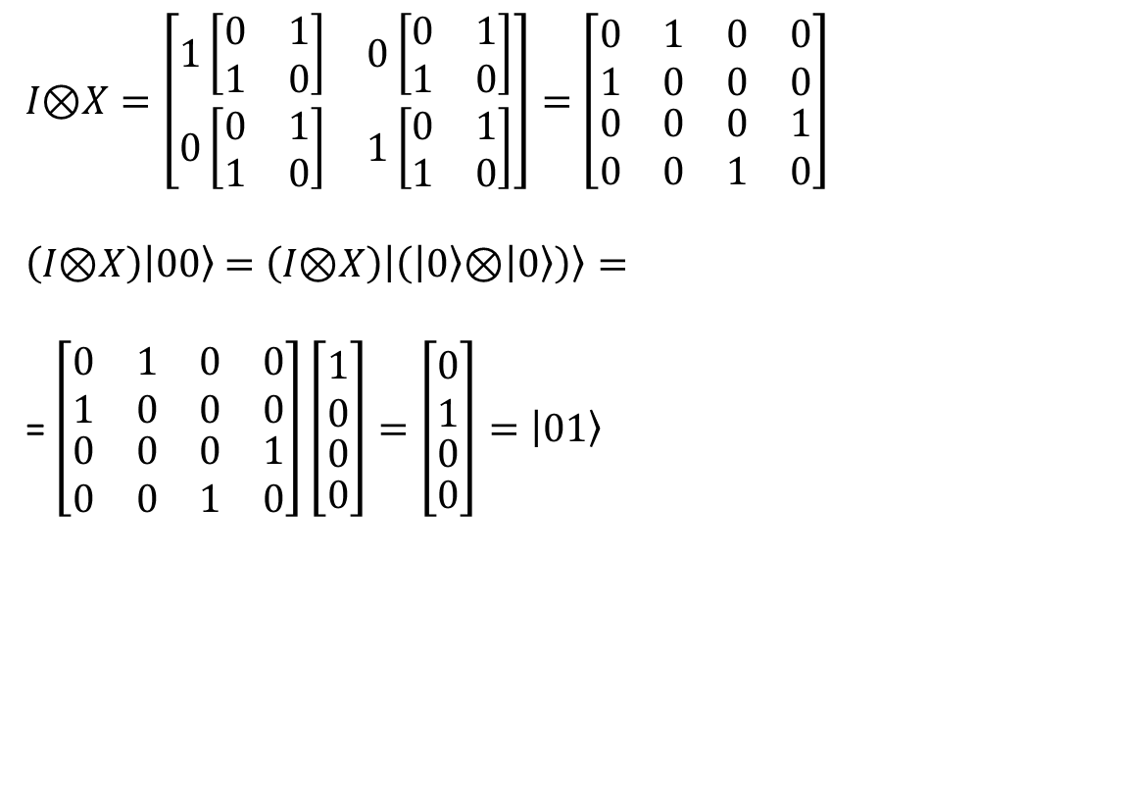
Multiple-Qubits Circuits: Example 1
$I\text{⊗}X=\left[\begin{matrix}1\left[\begin{matrix}0 & 1 \\ 1 & 0\end{matrix}\right] & 0\left[\begin{matrix}0 & 1 \\ 1 & 0\end{matrix}\right] \\ 0\left[\begin{matrix}0 & 1 \\ 1 & 0\end{matrix}\right] & 1\left[\begin{matrix}0 & 1 \\ 1 & 0\end{matrix}\right]\end{matrix}\right]=$ $\left[\begin{matrix}\begin{matrix}0 & 1 \\ 1 & 0\end{matrix} & \begin{matrix}0 & 0 \\ 0 & 0\end{matrix} \\ \begin{matrix}0 & 0 \\ 0 & 0\end{matrix} & \begin{matrix}0 & 1 \\ 1 & 0\end{matrix}\end{matrix}\right]$
$\left(I\text{⊗}X\right)\left|00\right\rangle$ $=\left(I\text{⊗}X\right)\left|\left(\left|0\right\rangle \text{⊗}\left|0\right\rangle \right)\right\rangle =$ = $\left[\begin{matrix}\begin{matrix}0 & 1 \\ 1 & 0\end{matrix} & \begin{matrix}0 & 0 \\ 0 & 0\end{matrix} \\ \begin{matrix}0 & 0 \\ 0 & 0\end{matrix} & \begin{matrix}0 & 1 \\ 1 & 0\end{matrix}\end{matrix}\right]\left[\begin{aligned}\begin{aligned}\begin{matrix}1 \\ 0\end{matrix} \\ 0\end{aligned} \\ 0\end{aligned}\right]=\left[\begin{aligned}\begin{aligned}\begin{matrix}0 \\ 1\end{matrix} \\ 0\end{aligned} \\ 0\end{aligned}\right]=\left|01\right\rangle$
I
$$\left|0\right\rangle$$
$$\left(I\text{⊗}X\right)\left|\left(\left|0\right\rangle \text{⊗}\left|0\right\rangle \right)\right\rangle$$
$$\left|0\right\rangle$$
X

Slide 52



Multiple-Qubits Circuits: Example 2
$$\left|0\right\rangle$$
H
$$\left(H\text{⊗}X\right)\left|\left(\left|0\right\rangle \text{⊗}\left|0\right\rangle \right)\right\rangle$$
$$\left|0\right\rangle$$
X

Slide 53
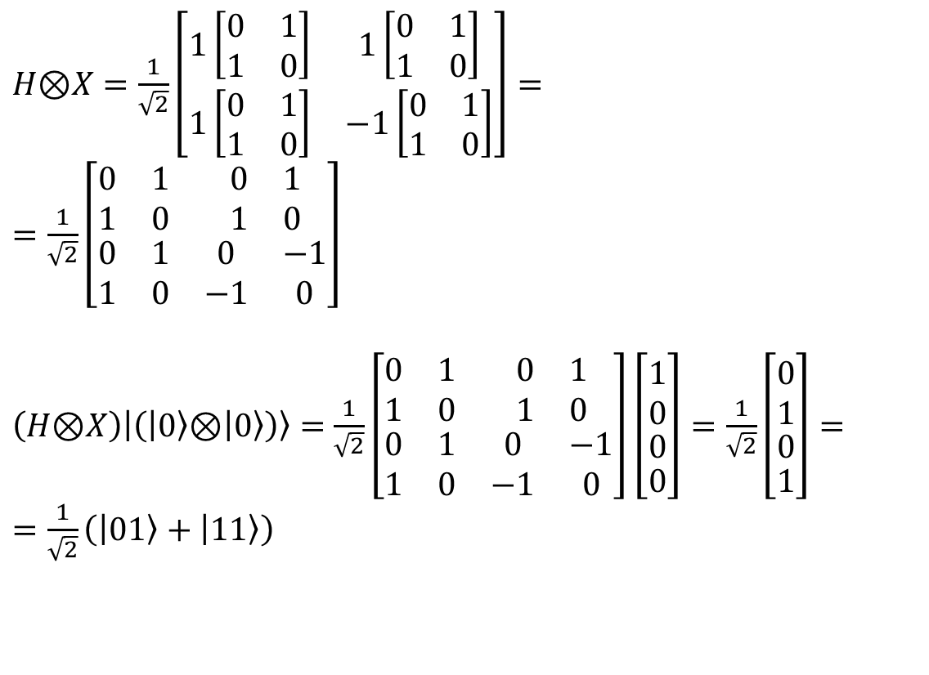
Multiple-Qubits Circuits: Example 2
$H\text{⊗}X=\frac{1}{\sqrt{2}}\left[\begin{matrix}1\left[\begin{matrix}0 & 1 \\ 1 & 0\end{matrix}\right] & 1\left[\begin{matrix}0 & 1 \\ 1 & 0\end{matrix}\right] \\ 1\left[\begin{matrix}0 & 1 \\ 1 & 0\end{matrix}\right] & −1\left[\begin{matrix}0 & 1 \\ 1 & 0\end{matrix}\right]\end{matrix}\right]=$ $=\frac{1}{\sqrt{2}}\left[\begin{matrix}\begin{matrix}0 & 1 \\ 1 & 0\end{matrix} & \begin{matrix}0 & 1 \\ 1 & 0\end{matrix} \\ \begin{matrix}0 & 1 \\ 1 & 0\end{matrix} & \begin{matrix}0 & −1 \\ −1 & 0\end{matrix}\end{matrix}\right]$
$\left(H\text{⊗}X\right)\left|\left(\left|0\right\rangle \text{⊗}\left|0\right\rangle \right)\right\rangle =$ $\frac{1}{\sqrt{2}}\left[\begin{matrix}\begin{matrix}0 & 1 \\ 1 & 0\end{matrix} & \begin{matrix}0 & 1 \\ 1 & 0\end{matrix} \\ \begin{matrix}0 & 1 \\ 1 & 0\end{matrix} & \begin{matrix}0 & −1 \\ −1 & 0\end{matrix}\end{matrix}\right]\left[\begin{aligned}\begin{aligned}\begin{matrix}1 \\ 0\end{matrix} \\ 0\end{aligned} \\ 0\end{aligned}\right]=\frac{1}{\sqrt{2}}\left[\begin{aligned}\begin{aligned}\begin{matrix}0 \\ 1\end{matrix} \\ 0\end{aligned} \\ 1\end{aligned}\right]=$ $=\frac{1}{\sqrt{2}}\left(\left|01\right\rangle +\left|11\right\rangle \right)$
H
$$\left|0\right\rangle$$
$$\left(H\text{⊗}X\right)\left|\left(\left|0\right\rangle \text{⊗}\left|0\right\rangle \right)\right\rangle$$
$$\left|0\right\rangle$$
X

Slide 54



Multiple-Qubits Circuits: Example 3
$$\left|0\right\rangle$$
H
$$\left(H\text{⊗}H\right)\left|\left(\left|0\right\rangle \text{⊗}\left|0\right\rangle \right)\right\rangle$$
$$\left|0\right\rangle$$
H

Slide 55

Multiple-Qubits Circuits: Example 3
$$H\text{⊗}H=\frac{1}{\sqrt{2}}\left[\begin{matrix}\frac{1}{\sqrt{2}}\left[\begin{matrix}1 & 1 \\ 1 & −1\end{matrix}\right] & \frac{1}{\sqrt{2}}\left[\begin{matrix}1 & 1 \\ 1 & −1\end{matrix}\right] \\ \frac{1}{\sqrt{2}}\left[\begin{matrix}1 & 1 \\ 1 & −1\end{matrix}\right] & −\frac{1}{\sqrt{2}}\left[\begin{matrix}1 & 1 \\ 1 & −1\end{matrix}\right]\end{matrix}\right]=\frac{1}{2}\left[\begin{matrix}\begin{matrix}1 & 1 \\ 1 & −1\end{matrix} & \begin{matrix}1 & 1 \\ 1 & −1\end{matrix} \\ \begin{matrix}1 & 1 \\ 1 & −1\end{matrix} & \begin{matrix}−1 & −1 \\ −1 & 1\end{matrix}\end{matrix}\right]$$
$$\left(H\text{⊗}H\right)\left|\left(\left|0\right\rangle \text{⊗}\left|0\right\rangle \right)\right\rangle =\frac{1}{\sqrt{2}}\left[\begin{matrix}\begin{matrix}1 & 1 \\ 1 & −1\end{matrix} & \begin{matrix}1 & 1 \\ 1 & −1\end{matrix} \\ \begin{matrix}1 & 1 \\ 1 & −1\end{matrix} & \begin{matrix}−1 & −1 \\ −1 & 1\end{matrix}\end{matrix}\right]\left[\begin{aligned}\begin{aligned}\begin{matrix}1 \\ 0\end{matrix} \\ 0\end{aligned} \\ 0\end{aligned}\right]=\frac{1}{2}\left[\begin{aligned}\begin{aligned}\begin{matrix}1 \\ 1\end{matrix} \\ 1\end{aligned} \\ 1\end{aligned}\right]=\frac{1}{2}\left(\left|00\right\rangle +\left|01\right\rangle +\left|10\right\rangle +\left|11\right\rangle \right)$$
H
$$\left|0\right\rangle$$
$$\left(H\text{⊗}H\right)\left|\left(\left|0\right\rangle \text{⊗}\left|0\right\rangle \right)\right\rangle$$
$$\left|0\right\rangle$$
H

Slide 56
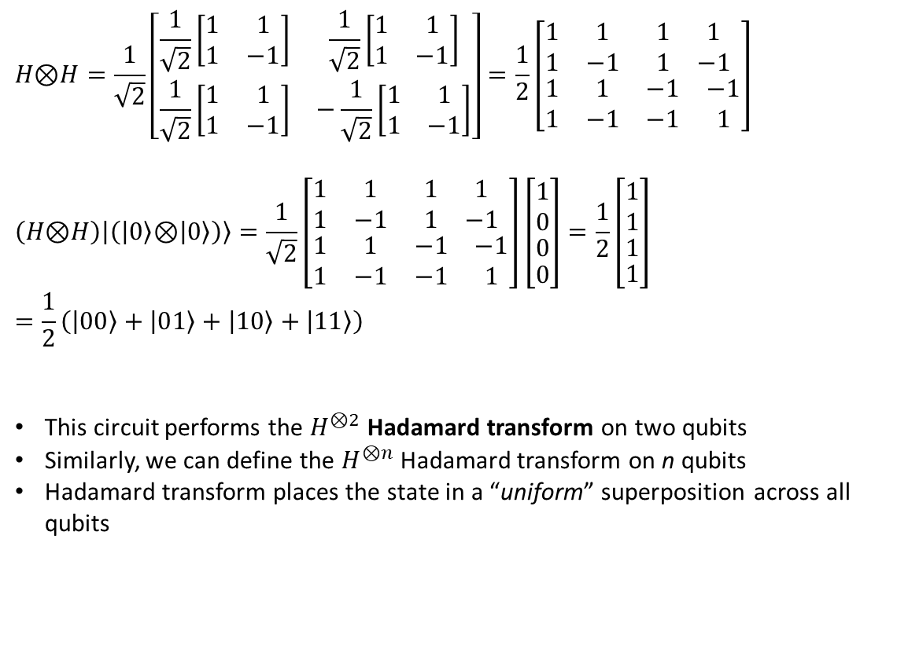
Multiple-Qubits Circuits: Example 3
$$H\text{⊗}H=\frac{1}{\sqrt{2}}\left[\begin{matrix}\frac{1}{\sqrt{2}}\left[\begin{matrix}1 & 1 \\ 1 & −1\end{matrix}\right] & \frac{1}{\sqrt{2}}\left[\begin{matrix}1 & 1 \\ 1 & −1\end{matrix}\right] \\ \frac{1}{\sqrt{2}}\left[\begin{matrix}1 & 1 \\ 1 & −1\end{matrix}\right] & −\frac{1}{\sqrt{2}}\left[\begin{matrix}1 & 1 \\ 1 & −1\end{matrix}\right]\end{matrix}\right]=\frac{1}{2}\left[\begin{matrix}\begin{matrix}1 & 1 \\ 1 & −1\end{matrix} & \begin{matrix}1 & 1 \\ 1 & −1\end{matrix} \\ \begin{matrix}1 & 1 \\ 1 & −1\end{matrix} & \begin{matrix}−1 & −1 \\ −1 & 1\end{matrix}\end{matrix}\right]$$
$$\left(H\text{⊗}H\right)\left|\left(\left|0\right\rangle \text{⊗}\left|0\right\rangle \right)\right\rangle =\frac{1}{\sqrt{2}}\left[\begin{matrix}\begin{matrix}1 & 1 \\ 1 & −1\end{matrix} & \begin{matrix}1 & 1 \\ 1 & −1\end{matrix} \\ \begin{matrix}1 & 1 \\ 1 & −1\end{matrix} & \begin{matrix}−1 & −1 \\ −1 & 1\end{matrix}\end{matrix}\right]\left[\begin{aligned}\begin{aligned}\begin{matrix}1 \\ 0\end{matrix} \\ 0\end{aligned} \\ 0\end{aligned}\right]=\frac{1}{2}\left[\begin{aligned}\begin{aligned}\begin{matrix}1 \\ 1\end{matrix} \\ 1\end{aligned} \\ 1\end{aligned}\right]=\frac{1}{2}\left(\left|00\right\rangle +\left|01\right\rangle +\left|10\right\rangle +\left|11\right\rangle \right)$$
This circuit performs the $H^{⊗2}$ Hadamard transform on two qubits
Similarly, we can define the $H^{⊗n}$ Hadamard transform on n qubits
Hadamard transform places the state in a “uniform” superposition across all qubits
H
$$\left|0\right\rangle$$
$$\left(H\text{⊗}H\right)\left|\left(\left|0\right\rangle \text{⊗}\left|0\right\rangle \right)\right\rangle$$
$$\left|0\right\rangle$$
H

Slide 57
Multiple-Qubits Gates
There are quantum gates which apply only to multiple qubits
CNOT
SWAP
CCNOT (Toffoli gate)
…

Slide 58


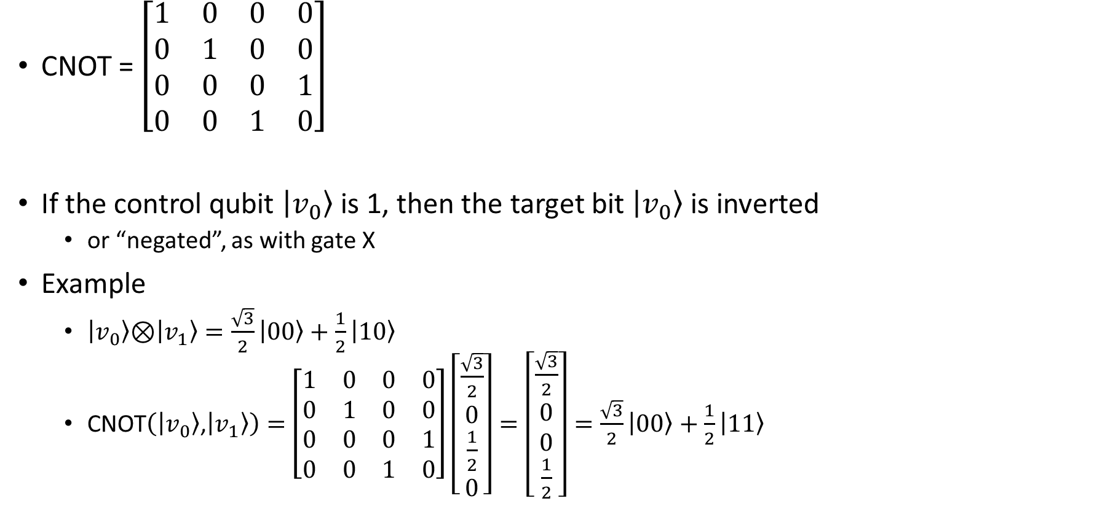



Multiple-Qubits Gates: Controlled NOT (CNOT)
CNOT = $\left[\begin{matrix}1 & 0 & 0 & 0 \\ 0 & 1 & 0 & 0 \\ 0 & 0 & 0 & 1 \\ 0 & 0 & 1 & 0\end{matrix}\right]$
If the control qubit $\left|v_{0}\right\rangle$ is 1, then the target bit $\left|v_{0}\right\rangle$ is inverted
or “negated”, as with gate X
Example
$\left|v_{0}\right\rangle \text{⊗}\left|v_{1}\right\rangle =\frac{\sqrt{3}}{2}\left|00\right\rangle +\frac{1}{2}\left|10\right\rangle$
CNOT$\left(\left|v_{0}\right\rangle \text{,}\left|v_{1}\right\rangle \right)=$ $\left[\begin{matrix}1 & 0 & 0 & 0 \\ 0 & 1 & 0 & 0 \\ 0 & 0 & 0 & 1 \\ 0 & 0 & 1 & 0\end{matrix}\right]\left[\begin{aligned}\frac{\sqrt{3}}{2} \\ 0 \\ \frac{1}{2} \\ 0\end{aligned}\right]=\left[\begin{aligned}\frac{\sqrt{3}}{2} \\ 0 \\ 0 \\ \frac{1}{2}\end{aligned}\right]=\frac{\sqrt{3}}{2}\left|00\right\rangle +\frac{1}{2}\left|11\right\rangle$
$$\left|v_{0}\right\rangle$$
$$\left|v_{0}\right\rangle$$
$$\left|v_{1}\right\rangle$$
$$\left|v_{0}\right\rangle ⊕\left|v_{1}\right\rangle$$
($⊕$ is the XOR operator)

Slide 59
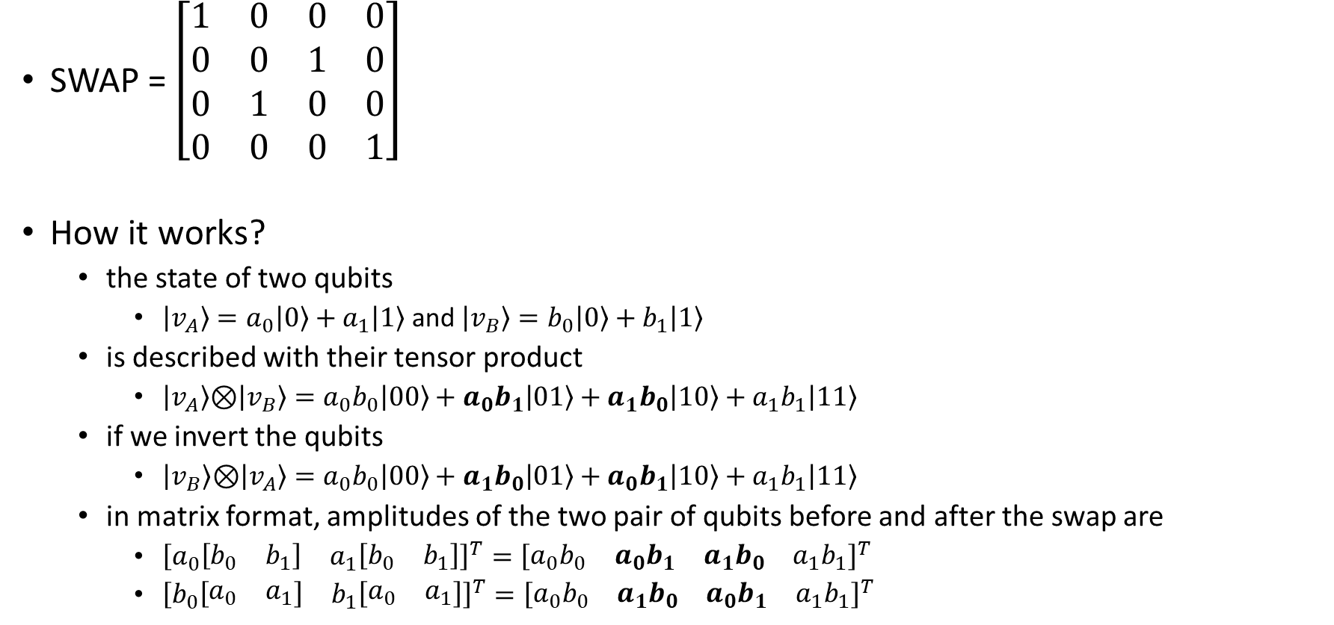


Multiple-Qubits Gates: SWAP
SWAP = $\left[\begin{matrix}1 & 0 & 0 & 0 \\ 0 & 0 & 1 & 0 \\ 0 & 1 & 0 & 0 \\ 0 & 0 & 0 & 1\end{matrix}\right]$
How it works?
the state of two qubits
$\left|v_{A}\right\rangle =a_{0}\left|0\right\rangle +a_{1}\left|1\right\rangle$ and $\left|v_{B}\right\rangle =b_{0}\left|0\right\rangle +b_{1}\left|1\right\rangle$
is described with their tensor product
$\left|v_{A}\right\rangle \text{⊗}\left|v_{B}\right\rangle =a_{0}b_{0}\left|00\right\rangle +a_{0}b_{1}\left|01\right\rangle +a_{1}b_{0}\left|10\right\rangle +a_{1}b_{1}\left|11\right\rangle$
if we invert the qubits
$\left|v_{B}\right\rangle \text{⊗}\left|v_{A}\right\rangle =a_{0}b_{0}\left|00\right\rangle +a_{1}b_{0}\left|01\right\rangle +a_{0}b_{1}\left|10\right\rangle +a_{1}b_{1}\left|11\right\rangle$
in matrix format, amplitudes of the two pair of qubits before and after the swap are
${\left[\begin{matrix}a_{0}\left[\begin{matrix}b_{0} & b_{1}\end{matrix}\right] & a_{1}\left[\begin{matrix}b_{0} & b_{1}\end{matrix}\right]\end{matrix}\right]}^{T}={\left[\begin{matrix}a_{0}b_{0} & a_{0}b_{1} & a_{1}b_{0} & a_{1}b_{1}\end{matrix}\right]}^{T}$
${\left[\begin{matrix}b_{0}\left[\begin{matrix}a_{0} & a_{1}\end{matrix}\right] & b_{1}\left[\begin{matrix}a_{0} & a_{1}\end{matrix}\right]\end{matrix}\right]}^{T}={\left[\begin{matrix}a_{0}b_{0} & a_{1}b_{0} & a_{0}b_{1} & a_{1}b_{1}\end{matrix}\right]}^{T}$
$$\left|v_{0}\right\rangle$$
$$\left|v_{1}\right\rangle$$
$$\left|v_{1}\right\rangle$$
$$\left|v_{0}\right\rangle$$

Slide 60
















Multiple-Qubits Gates: SWAP as CNOT^3
$$\left|v_{0}\right\rangle$$
$$\left|v_{1}\right\rangle$$
$$\left|0\right\rangle$$
$$\left|0\right\rangle$$
$$\left|1\right\rangle$$
$$\left|1\right\rangle$$
$$\left|v_{1}\right\rangle$$
$$\left|v_{0}\right\rangle$$
$$\left|1\right\rangle$$
$$\left|1\right\rangle$$
$$\left|1\right\rangle$$
$$\left|0\right\rangle$$
$$\left|1\right\rangle$$
$$\left|1\right\rangle$$
$$\left|0\right\rangle$$
$$\left|0\right\rangle$$
$$\left|0\right\rangle$$
$$\left|1\right\rangle$$
$$\left|1\right\rangle$$
$$\left|1\right\rangle$$

Slide 61



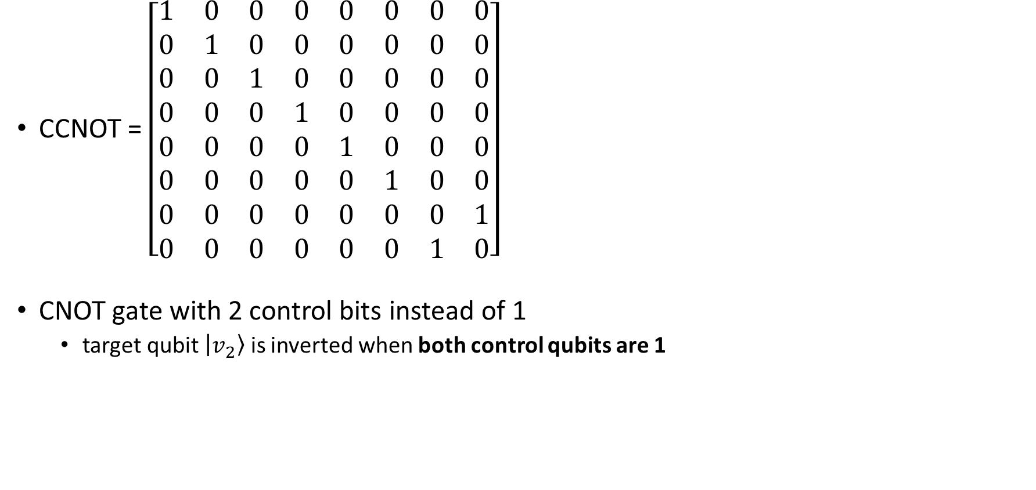



Multiple-Qubits Gates: CCNOT (or Toffoli)
CCNOT = $\left[\begin{matrix}1 & 0 & 0 & 0 & 0 & 0 & 0 & 0 \\ 0 & 1 & 0 & 0 & 0 & 0 & 0 & 0 \\ 0 & 0 & 1 & 0 & 0 & 0 & 0 & 0 \\ 0 & 0 & 0 & 1 & 0 & 0 & 0 & 0 \\ 0 & 0 & 0 & 0 & 1 & 0 & 0 & 0 \\ 0 & 0 & 0 & 0 & 0 & 1 & 0 & 0 \\ 0 & 0 & 0 & 0 & 0 & 0 & 0 & 1 \\ 0 & 0 & 0 & 0 & 0 & 0 & 1 & 0\end{matrix}\right]$
CNOT gate with 2 control bits instead of 1
target qubit $\left|v_{2}\right\rangle$ is inverted when both control qubits are 1
$$\left|v_{0}\right\rangle$$
$$\left|v_{0}\right\rangle$$
$$\left|v_{1}\right\rangle$$
$$\left|v_{1}\right\rangle$$
$$\left|v_{2}\right\rangle$$
$$\left|v_{2}\right\rangle ⊕\left(\left|v_{0}\right\rangle ∧\left|v_{1}\right\rangle \right)$$

Slide 62
Universal quantum gates
Finite set of gates that can approximate any quantum circuit
any other unitary operation
Two-qubit gates are universal
any arbitrary n-qubit operation can be decomposed as a product of two-qubit gates
Many possible choices
Toffoli + Hadamard
…

Slide 63
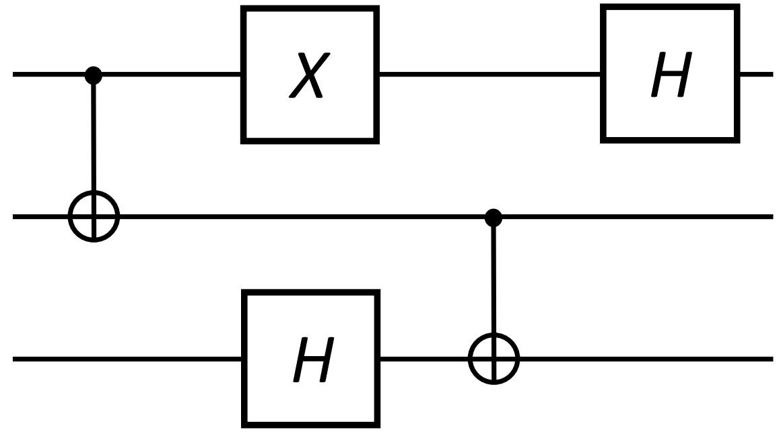
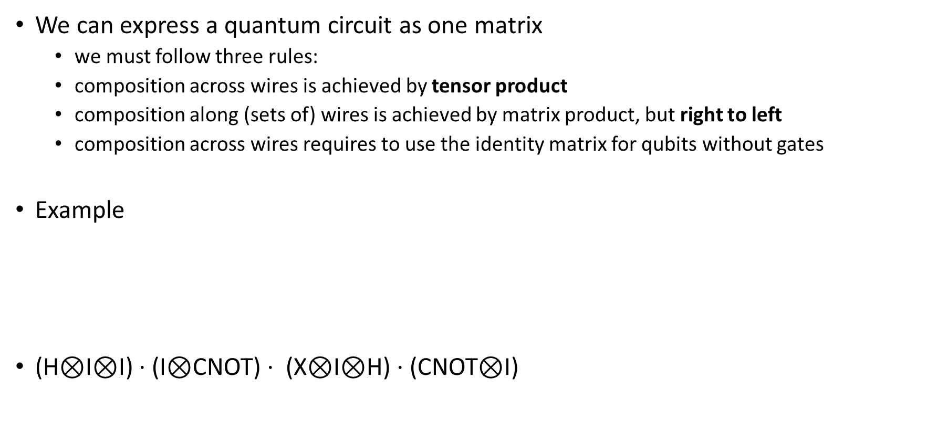
Quantum Circuit
We can express a quantum circuit as one matrix
we must follow three rules:
composition across wires is achieved by tensor product
composition along (sets of) wires is achieved by matrix product, but right to left
composition across wires requires to use the identity matrix for qubits without gates
Example
(H⊗I⊗I) $⋅$(I⊗CNOT) $⋅$ (X⊗I⊗H) $⋅$(CNOT⊗I)

Slide 64
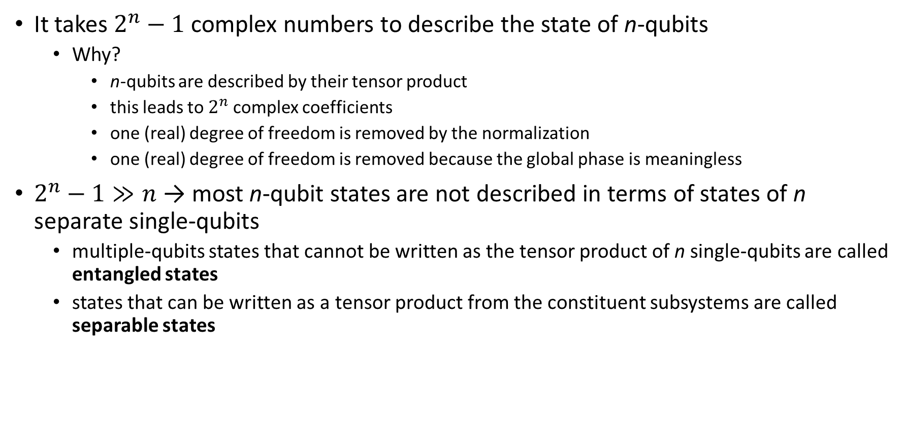
Entanglement
It takes $2^{n}−1$ complex numbers to describe the state of n-qubits
Why?
n-qubits are described by their tensor product
this leads to $2^{n}$complex coefficients
one (real) degree of freedom is removed by the normalization
one (real) degree of freedom is removed because the global phase is meaningless
$2^{n}−1≫n$ → most n-qubit states are not described in terms of states of n separate single-qubits
multiple-qubits states that cannot be written as the tensor product of n single-qubits are called entangled states
states that can be written as a tensor product from the constituent subsystems are called separable states

Slide 65
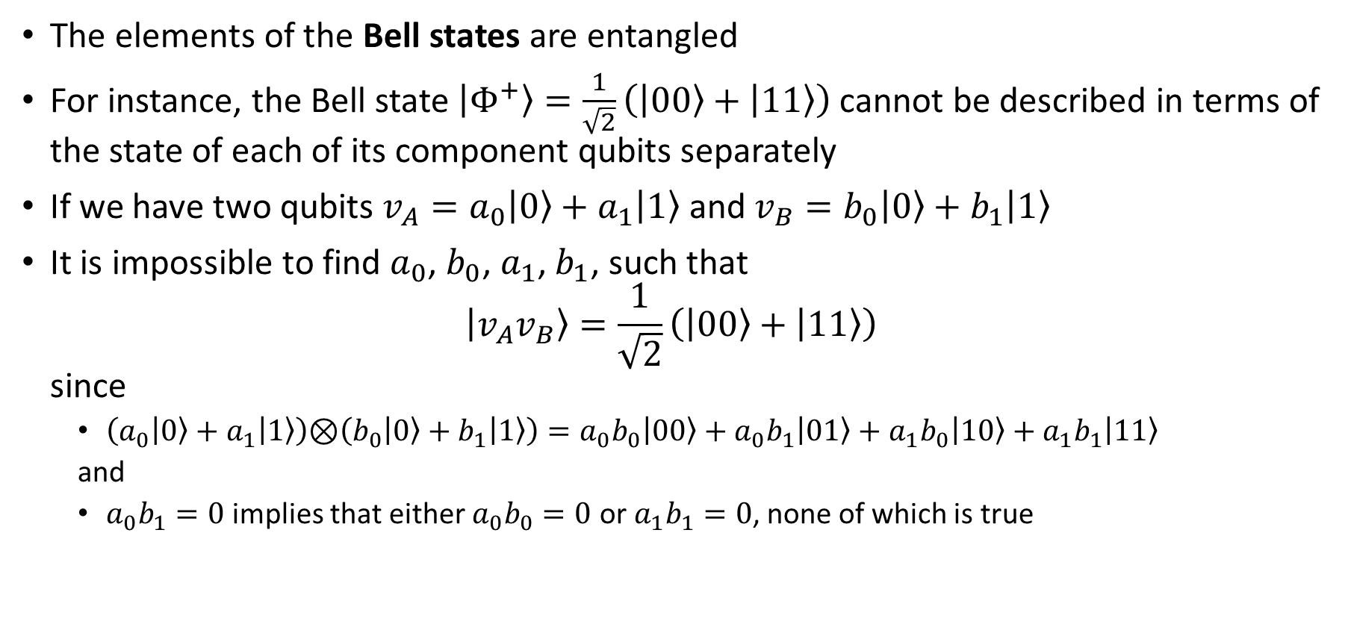
Entanglement example
The elements of the Bell states are entangled
For instance, the Bell state $\left|Φ^{+}\right\rangle =\frac{1}{\sqrt{2}}\left(\left|00\right\rangle +\left|11\right\rangle \right)$ cannot be described in terms of the state of each of its component qubits separately
If we have two qubits ${v_{A}=a}_{0}\left|0\right\rangle +a_{1}\left|1\right\rangle$ and ${v_{B}=b}_{0}\left|0\right\rangle +b_{1}\left|1\right\rangle$
It is impossible to find $a_{0}$, $b_{0}$, $a_{1}$, $b_{1}$, such that $\left|v_{A}v_{B}\right\rangle =\frac{1}{\sqrt{2}}\left(\left|00\right\rangle +\left|11\right\rangle \right)$ since
$\left(a_{0}\left|0\right\rangle +a_{1}\left|1\right\rangle \right)\text{⊗}\left(b_{0}\left|0\right\rangle +b_{1}\left|1\right\rangle \right)=a_{0}b_{0}\left|00\right\rangle +a_{0}b_{1}\left|01\right\rangle +a_{1}b_{0}\left|10\right\rangle +a_{1}b_{1}\left|11\right\rangle$
and
$a_{0}b_{1}=0$ implies that either $a_{0}b_{0}=0$ or $a_{1}b_{1}=0$, none of which is true

Slide 66
Entanglement
Entanglement is not basis dependent
the notion of superposition is basis-dependent
Entanglement is not an absolute property of a quantum state
depends on the particular decomposition of the system into subsystems under consideration
states entangled with respect to one decomposition may be unentangled with respect to other decompositions
when we say that a state is entangled, we mean that it is entangled with respect to this decomposition into individual qubits

Slide 67
Entangling gates
Not all two-qubit gates can be written as the tensor product of single-qubit gates
A generic 2-qubits gate has 16 complex values
Two single-qubit gates have 4 + 4 = 8 total complex values
Such a gate is called an entangling gate
One example of an entangling gate is the CNOT gate.

Slide 68
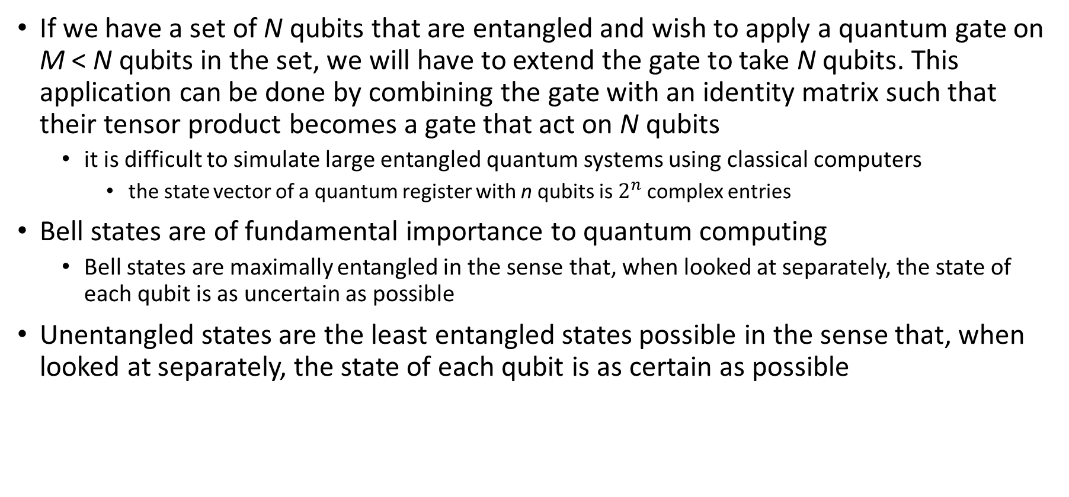
Entanglement
If we have a set of N qubits that are entangled and wish to apply a quantum gate on M < N qubits in the set, we will have to extend the gate to take N qubits. This application can be done by combining the gate with an identity matrix such that their tensor product becomes a gate that act on N qubits
it is difficult to simulate large entangled quantum systems using classical computers
the state vector of a quantum register with n qubits is $2^{n}$complex entries
Bell states are of fundamental importance to quantum computing
Bell states are maximally entangled in the sense that, when looked at separately, the state of each qubit is as uncertain as possible
Unentangled states are the least entangled states possible in the sense that, when looked at separately, the state of each qubit is as certain as possible

Slide 69
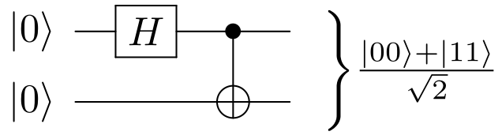
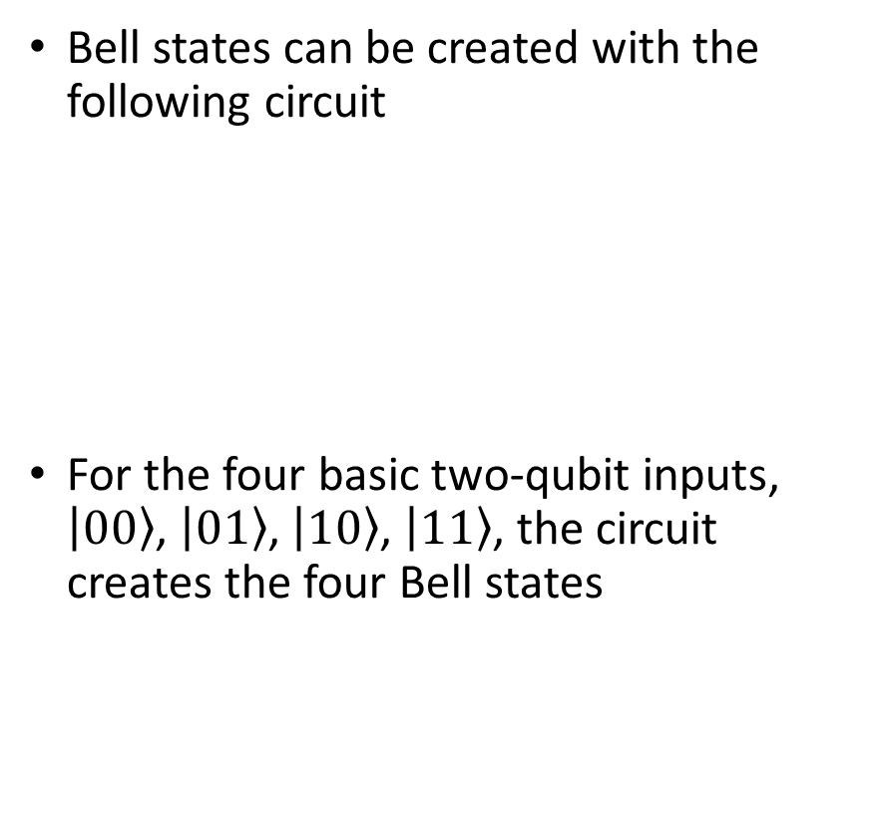
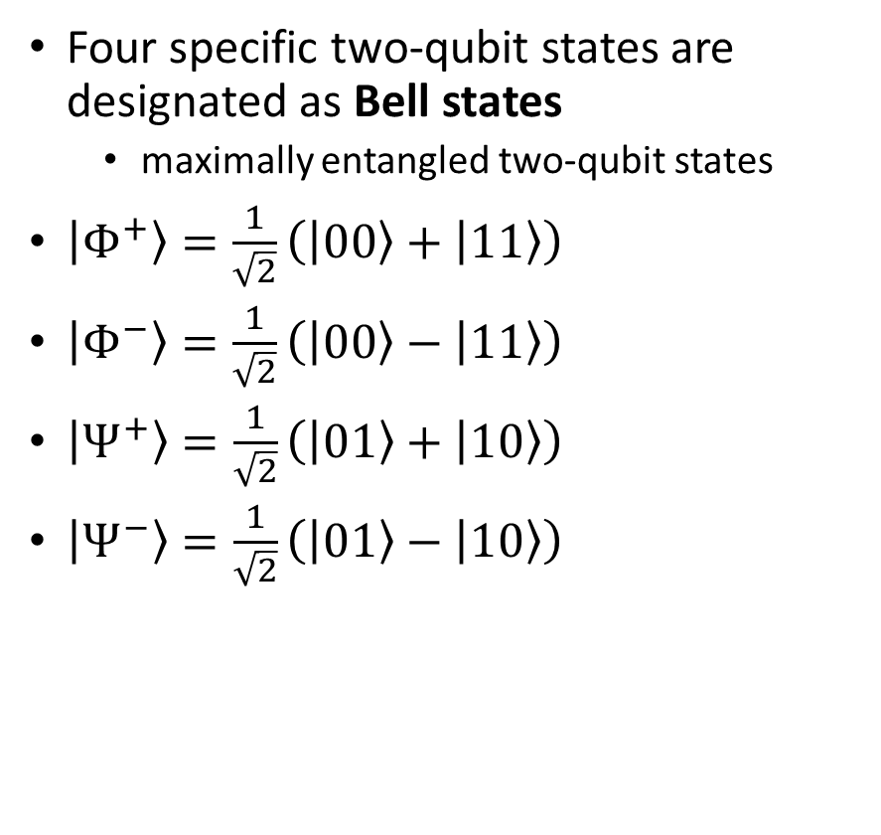
Bell states
Four specific two-qubit states are designated as Bell states
maximally entangled two-qubit states
$\left|Φ^{+}\right\rangle =\frac{1}{\sqrt{2}}\left(\left|00\right\rangle +\left|11\right\rangle \right)$
$\left|Φ^{−}\right\rangle =\frac{1}{\sqrt{2}}\left(\left|00\right\rangle −\left|11\right\rangle \right)$
$\left|Ψ^{+}\right\rangle =\frac{1}{\sqrt{2}}\left(\left|01\right\rangle +\left|10\right\rangle \right)$
$\left|Ψ^{−}\right\rangle =\frac{1}{\sqrt{2}}\left(\left|01\right\rangle −\left|10\right\rangle \right)$
Bell states can be created with the following circuit
For the four basic two-qubit inputs, $\left|00\right\rangle$, $\left|01\right\rangle$, $\left|10\right\rangle$, $\left|11\right\rangle$, the circuit creates the four Bell states

Slide 70

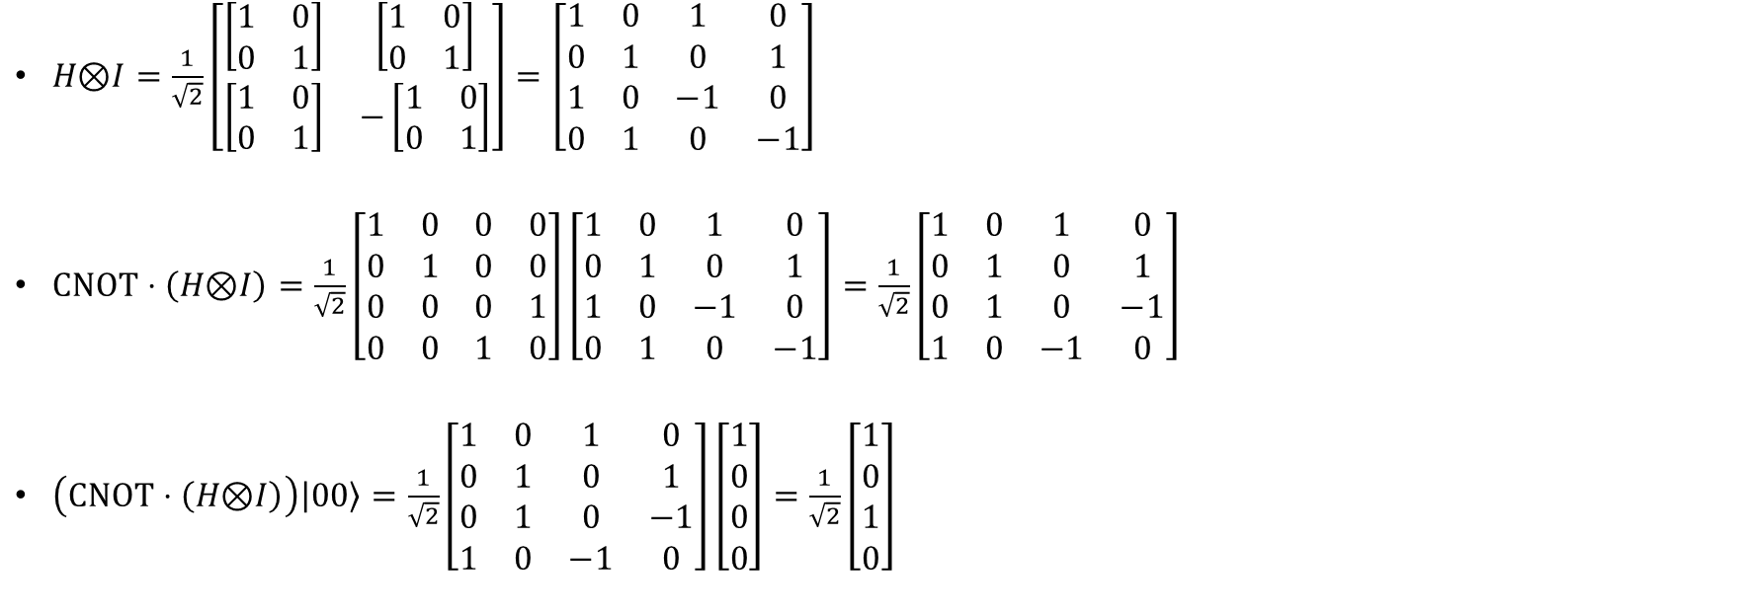




Bell states: how to create (example)
$$\left|0\right\rangle$$
$$\left(CNOT⋅\left(H\text{⊗}I\right)\right)\left|\left(\left|v_{0}\right\rangle \text{⊗}\left|v_{1}\right\rangle \right)\right\rangle$$
$$\left|0\right\rangle$$
$H\text{⊗}I=\frac{1}{\sqrt{2}}\left[\begin{matrix}\left[\begin{matrix}1 & 0 \\ 0 & 1\end{matrix}\right] & \left[\begin{matrix}1 & 0 \\ 0 & 1\end{matrix}\right] \\ \left[\begin{matrix}1 & 0 \\ 0 & 1\end{matrix}\right] & −\left[\begin{matrix}1 & 0 \\ 0 & 1\end{matrix}\right]\end{matrix}\right]=\left[\begin{matrix}1 & 0 & 1 & 0 \\ 0 & 1 & 0 & 1 \\ 1 & 0 & −1 & 0 \\ 0 & 1 & 0 & −1\end{matrix}\right]$
$CNOT⋅\left(H\text{⊗}I\right)=\frac{1}{\sqrt{2}}\left[\begin{matrix}1 & 0 & 0 & 0 \\ 0 & 1 & 0 & 0 \\ 0 & 0 & 0 & 1 \\ 0 & 0 & 1 & 0\end{matrix}\right]\left[\begin{matrix}1 & 0 & 1 & 0 \\ 0 & 1 & 0 & 1 \\ 1 & 0 & −1 & 0 \\ 0 & 1 & 0 & −1\end{matrix}\right]=\frac{1}{\sqrt{2}}\left[\begin{matrix}1 & 0 & 1 & 0 \\ 0 & 1 & 0 & 1 \\ 0 & 1 & 0 & −1 \\ 1 & 0 & −1 & 0\end{matrix}\right]$
$\left(CNOT⋅\left(H\text{⊗}I\right)\right)\left|00\right\rangle =\frac{1}{\sqrt{2}}\left[\begin{matrix}1 & 0 & 1 & 0 \\ 0 & 1 & 0 & 1 \\ 0 & 1 & 0 & −1 \\ 1 & 0 & −1 & 0\end{matrix}\right]\left[\begin{aligned}1 \\ 0 \\ 0 \\ 0\end{aligned}\right]=\frac{1}{\sqrt{2}}\left[\begin{aligned}1 \\ 0 \\ 1 \\ 0\end{aligned}\right]$
this operator creates Bell states

Slide 71
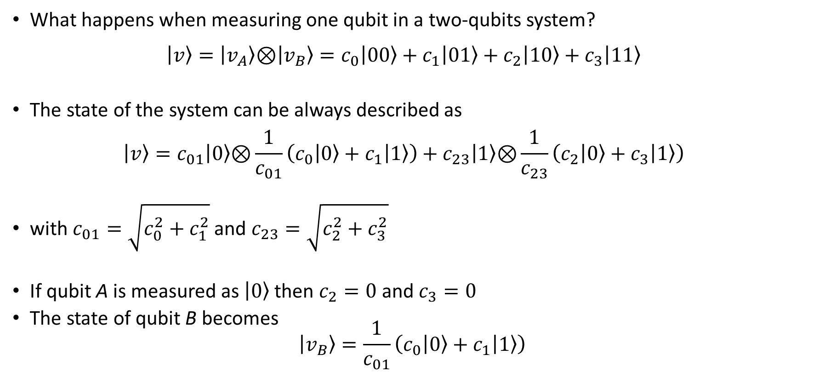

Multi qubits measurement
What happens when measuring one qubit in a two-qubits system? $\left|v\right\rangle =\left|v_{A}\right\rangle \text{⊗}\left|v_{B}\right\rangle =c_{0}\left|00\right\rangle +c_{1}\left|01\right\rangle +c_{2}\left|10\right\rangle +c_{3}\left|11\right\rangle$
The state of the system can be always described as $\left|v\right\rangle =c_{01}\left|0\right\rangle \text{⊗}\frac{1}{c_{01}}\left(c_{0}\left|0\right\rangle +c_{1}\left|1\right\rangle \right)+c_{23}\left|1\right\rangle \text{⊗}\frac{1}{c_{23}}\left(c_{2}\left|0\right\rangle +c_{3}\left|1\right\rangle \right)$
with $c_{01}=\sqrt{c_{0}^{2}+c_{1}^{2}}$ and $c_{23}=\sqrt{c_{2}^{2}+c_{3}^{2}}$
If qubit A is measured as $\left|0\right\rangle$ then $c_{2}=0$ and $c_{3}=0$
The state of qubit B becomes $\left|v_{B}\right\rangle =\frac{1}{c_{01}}\left(c_{0}\left|0\right\rangle +c_{1}\left|1\right\rangle \right)$
this is a valid qubit (normalized to 1)

Slide 72

Multi qubits measurement: example
What happens when measuring one qubit in a two-qubits system? $\left|v\right\rangle =\frac{1}{\sqrt{2}}\left(\left|00\right\rangle +\left|11\right\rangle \right)$
The state of the system can be described as $\left|v\right\rangle =\frac{1}{\sqrt{2}}\left|0\right\rangle \text{⊗}\left|0\right\rangle +\frac{1}{\sqrt{2}}\left|1\right\rangle \text{⊗}\left|1\right\rangle$
If qubit A is measured as $\left|0\right\rangle$ the state of qubit B becomes $\left|v_{B}\right\rangle =\left|0\right\rangle$
If qubit A is measured as $\left|1\right\rangle$ the state of qubit B becomes $\left|v_{B}\right\rangle =\left|1\right\rangle$
The measurement of a bit determines the second qu-bit
This is weird, since the measurement affects only 1 bit

Slide 73


Slide 74
Quantum Algorithms and Technologies

Slide 75
Quantum Algorithms
Quantum algorithm's structure:
Work on multi qubits in superposition states
The operations performed on the qubits are chosen to get to a final superposition state
Measuring this state generally yields the solution of the problem with probability close to 1
Quantum algorithms have usually a classical part too, where standard bits are employed

Slide 76
Quantum Technologies
Quantum Technologies are extremely fragile
Quantum Computation Errors
A qubit is affected by external noise
For instance, the Brownian motions of the molecules may interfere with the quantum estate
Each qubit has a decoherence time
the maximum time a qubit can keep its superposition state
typically, in the order of tens of µs
Error correction codes are necessary to preserve the computation

Slide 77

Quantum Error Correction Codes (QECC)
Correction process is carried on after each operation
redundancy is employed to correct errors
a lot of redundancy is necessary, since:
qubits are continuous, not discrete
error rate is high
each qubit becomes a logical qubit, which is encoded in n physical qubits: data and ancilla ones
Error correction is the main responsible for the blowup of qubits required for quantum algorithms
N logical qubits requires
100x physical qubits (data, ancilla, wiring)
plus many more for other architecture details

Slide 78


QECC: Logical Gates
Quantum Operations on Logical Qubits
each fundamental gate needs to be defined on logical qubits
the way the logical operation is performed depends on the logical qubit imlementation
each logical operation is represented by a logical gate
cryogenic qubits: gates are implemented via microwave pulses (${10}^{−8}$ sec) sent to the qubits
We want to run different gates before decoherence time expires
data qubits
ancilla qubits

Slide 79
Quantum Computation Concepts
Quantum Processor: chip with n logical qubits
Quantum Language Programming: language to describe a circuit using gate-level instructions or known functions
Quantum Algorithm: quantum circuit to be executed
Quantum Compilation
Optimization: use heuristics to merge gates or rearrange operations
Placement: initial mapping of the circuit qubits to the on-chip logical qubits
Scheduling: schedule gates execution
Routing: move qubits to execute operations on multiple qubits
Quantum Execution: translation of gate-level instructions to signals sent to the processor

Slide 80











Quantum Compilation: Placement
Main issue to be addressed:
2 qubits of a non-single gate (e.g. CNOT) needs to be adjacent to compute the gate
adjacent: either on the same row or same column
if not, they need to be moved (routing process)
Placement: maps the qubits on chip, deriving the initial configuration of the processor
place as close as possible qubits that will be processed by a 2-qubits gate
minimize Manhattan distances
i.e., minimize routing cost (number of hops to move qubits)
example: CNOT$\left({v_{3},v}_{4}\right)$ → distance = 4
target: find the placement that minimizes the sum of Manhattan distances over all pairs involved in multiple bits gates
$$|v_{0}⟩$$
$$|v_{1}⟩$$
$$|v_{2}⟩$$
$$|v_{3}⟩$$
$$|v_{4}⟩$$
$$|v_{5}⟩$$
$$|v_{6}⟩$$
$$|v_{7}⟩$$
$$|v_{8}⟩$$
$$|v_{9}⟩$$

Slide 81
Quantum Compilation: Scheduling
Gates can theoretically be all executed simultaneously, but there are scheduling issues
data dependencies
out of order execution must preserve the correctness of the computation
Scheduling Policies
As Soon As Possible (ASAP)
an operation is performed as soon as the input data are available
As Late As Possible (ALAP)
mitigates decoherence time constraints
minimize the time between a gate writing a qubit and the next gate reading it
reduce the time interval a quantum state needs to be preserved

Slide 82

Quantum Compilation: Scheduling Example
ASAP Policy
INIT ψ₀, ψ₁, ψ₂, ψ₃, ψ₄, ψ₅, ψ₆
H(ψ₀), H(ψ₁), H(ψ₂), CNOT(ψ₃,ψ₄), CNOT(ψ₃,ψ₅)
CNOT(ψ₂,ψ₃), CNOT(ψ₂,ψ₄), CNOT(ψ₂,ψ₆), CNOT(ψ₁,ψ₅)
CNOT(ψ₁,ψ₃), CNOT(ψ₁,ψ₆), CNOT(ψ₀,ψ₄), CNOT(ψ₀,ψ₅)
CNOT(ψ₀,ψ₆)
ALAP Policy (initialization as late as possible)
INIT ψ₂
INIT ψ₁, ψ₃, ψ₄, ψ₅, ψ₆, H(ψ₂)
INIT ψ₀, H(ψ₁), CNOT(ψ₃,ψ₄), CNOT(ψ₃,ψ₅), CNOT(ψ₂,ψ₆)
H(ψ₀), CNOT(ψ₂,ψ₃), CNOT(ψ₂,ψ₄), CNOT(ψ₁,ψ₆), CNOT(ψ₁,ψ₅)
CNOT(ψ₁,ψ₃), CNOT(ψ₀,ψ₄), CNOT(ψ₀,ψ₅), CNOT(ψ₀,ψ₆)

Slide 83




















Quantum Compilation: Routing
Multi qubit gates require qubits to be adjacent
if they are not, we need to move them. How?
using swap gate!
ALAP Policy (initialization as late as possible)
…
…
INIT ψ₀, H(ψ₁), CNOT(ψ₃,ψ₄), CNOT(ψ₃,ψ₅), CNOT(ψ₂,ψ₆)
↓
INIT ψ₀, H(ψ₁), CNOT(ψ₃,ψ₄), SWAP(ψ₃,ψ₅), CNOT(ψ₃,ψ₅), CNOT(ψ₂,ψ₆)
$$|v_{0}⟩$$
$$|v_{1}⟩$$
$$|v_{2}⟩$$
$$|v_{3}⟩$$
$$|v_{4}⟩$$
$$|v_{5}⟩$$
$$|v_{6}⟩$$
$$|v_{7}⟩$$
$$|v_{8}⟩$$
$$|v_{9}⟩$$
↓
$$|v_{0}⟩$$
$$|v_{1}⟩$$
$$|v_{2}⟩$$
$$|v_{5}⟩$$
$$|v_{4}⟩$$
$$|v_{3}⟩$$
$$|v_{6}⟩$$
$$|v_{7}⟩$$
$$|v_{8}⟩$$
$$|v_{9}⟩$$

